Slide 1
PLL and Freq Synthesizer Fundamentals
Presented by
John-Paul Caputo
For EE720 Spring 2012

Slide 2
Topics Covered
PLL basics: Uses
History The simple synchronous 1:1 frequency. 1:n frequency multiplication.
Frequency synthesizer using PLL.
Jitter / Phase noise basics.
Eye Pattern
Demo homebrew PLL and Freq Counter.

Slide 3
PLL Uses
Phase Tracking
Frequency Tracking
Frequency Multiplication / Division
Selected Frequency Synthesizing
Jitter Reduction

Slide 4
Quick PLL History
Early Radar during WW1
Television from the start 1930s/1940s
Used for Horizontal Sweep synchronization
Digital IC Radios from 1980s
Microprocessors and computers.

Slide 5
Basic Phase Locked Loop
Frequency in = Frequency out
Unity Frequency Feedback
Lock Onto and Track Input Signal

Slide 6
PLL Block Diagram
Phase
Detector
LPF
VCO
Frequency
Output
Input
Frequency
Divider

Slide 7
Vacuum Tube PLL Schematic

Slide 8
Building Blocks: Phase Detector
Phase Detector / Discriminator
Logic X-OR
Outputs PWM to a Low Pass Filter

Slide 9
Simple Phase Detector Schematic

Slide 10
Advanced Phase Detector Schematic

Slide 11
Low Pass Filter
Converts pulses from the Phase Detector to DC
Time Constant Long enough to provide DC But Short enough to adjust quickly.
DC signal used to drive the Voltage Controlled Oscillator

Slide 12
Voltage Controlled Oscillator
Needed to generate a sinusoid / periodic signal to track the input phase.
Any VCO design will work.
Generally a resistance or capacitance is varied to change the frequency. FET or Varactor Diode
Inductors are not used as automatic varying elements.

Slide 13
Sample VCO Schematic

Slide 14
Varactor Diode

Slide 15
Divide By N
Samples every N oscillations
Essentially a counter with carry out.
State Machine with all clear and carry out.

Slide 16
Frequency Multiplication / Division
Used to create a single new frequency.
Feedback Loop Contains Frequency Divider, aka Divide by N circuit.
VCO for desired output frequency is used

Slide 17
Frequency Multiplication / Division Block Diagram

Slide 18
Frequency Synthesizer
Starts with a Frequency multiplier / divider
Divide By N circuit is different.
Frequency is controlled by changing the Divide By N.
Wide Range VCO

Slide 19
Programmable Divide by N

Slide 20
Frequency Synthesizer Block Diagram

Slide 21
Frequency Synthesizer

Slide 22
PLL, Freq Multiplier, Freq Synthesizer Problems
Loss of Lock
Jitter and Phase noise.

Slide 23
Lock-On
Maintain lock over wide range
Lock On Problems after large phase excursions
Phase Detector design determines Lock On response
Oscillator freewheels until locked on

Slide 24
Phase Noise

Slide 25
Eye Pattern

Slide 26
Eye Pattern and Jitter Tolerance

Slide 27
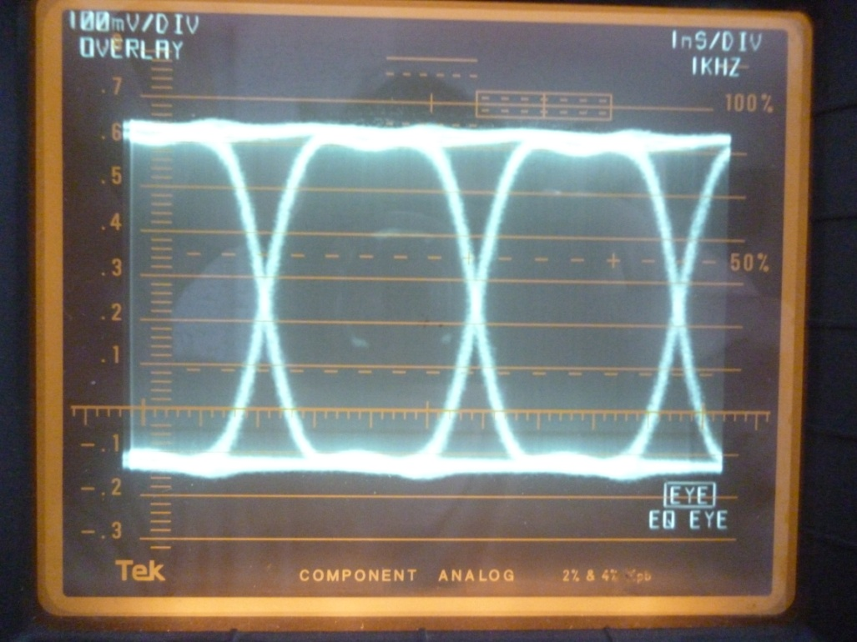
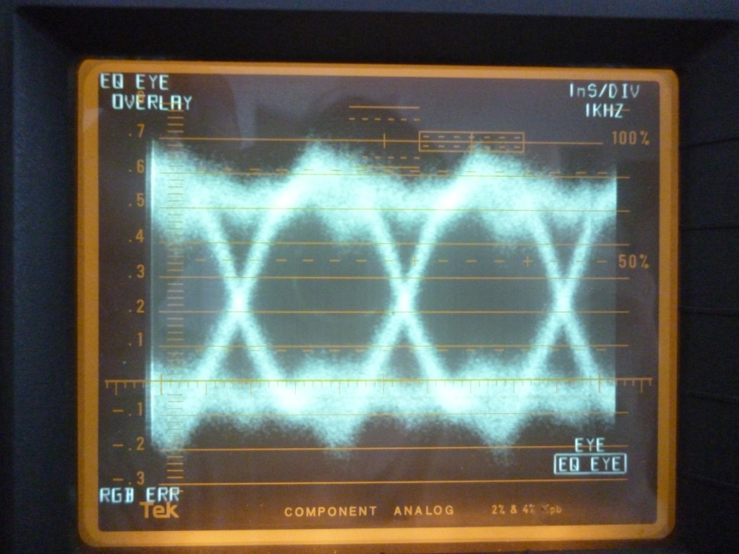
Actual Eye Pattern
Taken from Standard Def-Serial Digital Interface corrected output. SD-SDI video signal at 270Mbits

Slide 28
Digital Video Eye and Pulse Train

Slide 29
Data Noise and Jitter

Slide 30
Signal Degradation

Slide 31
Jitter
Caused when the oscillator is shifting, due to input / reference drift minutely and Instantaniously
Caused by Other Oscillators
Caused by Noise on the Voltage Rails.
Caused by thermal noise

Slide 32
Noise
RF Noise introduced from any system.
Causes voltage rails to not be pure.
Causes average data to have lower voltage differential than the rails.

Slide 33
Design Tips
Here are the details to consider when designing or selecting a PLL, Freq Multiplier, Freq Synth.

Slide 34
Design Tips
EXTERNAL REFERENCE
Clean the signal to remove as much external noise as possible.
INTERNAL REFERENCE
Reference Oscillator. Crystal or other stable low-noise, low drift oscillator.

Slide 35
Design Tips
FREQUENCY RANGE
Best operation Mid-Band.
Reliability compromised at ends of the component range

Slide 36
Design Tips
LOCK ON RESPONSE
Depends on Phase Detector
Depends on LPF design
Depends on Feedback loop response.
Can reduce output Jitter
Overcompensation will create a low frequency oscillation.

Slide 37
Design Tips
Jitter Handling
Jitter caused from tracking stability
Add A PLL loop to enhance stability and reduce jitter.

Slide 38
Extended Range PLL

Slide 39
Demo Basic PLL and Freq counter
PLL Schematic
12Vdc
V2
R2
27k
2
Q1
R4
0
L1
C3
Q2N2222
33k
R40
R42
R44
R46
3.25uH
470p
C5
Q2
1meg
15k
150k
10k
Varactors
1
R1
.1u
Q2N2222
R20
C30
D30
C40
Q40
C41
Q41
D1
15k
10k
1u
D1N4148
Q2N2222
NTE614
C1
C2
C4
R3
R5
R30
C31
R31
10u
10u
Q2N2222
D2
.01u
.01u
470p
1k
10k
R6
10k
470p
150k
R41
R43
R45
R47
NTE614
2k
150k
1k
20k
1k
0
0
R12
R22
27k
100k
R48
R401
R50
R52
2
Q11
R14
47k
10k
C50
33k
2k
C51
L11
C13
Q2N2222
33k
C42
Q42
Q50
3.25uH
470p
C15
Q12
10u
Q2N2222
C52
4.7u
1
R11
.1u
Q2N2222
R21
10u
Q2N2222
4.7u
15k
10k
R49
R402
R51
R53
R60
C11
C12
C14
R13
R15
R16
5.1k
1k
15k
0
2k
.01u
.01u
470p
1k
10k
2k
11k
0
R61
11k
Q64
Q65
R73
R71
R54
R56
C53
R58
Q2N2222
Q2N2222
R62
R70
Q70
1k
33k
2k
1k
2k
C70
R72
C55
Q51
4.7u
11k
10k
Q2N2222
4.7u
10k
Q2N2222
C54
R59
0
Q63
Q66
D70
10u
Q2N2222
Q2N2222
D1N4148
1Vac
V1
R55
R57
4.7u
11k
D71
0Vdc
15k
2k
D1N4148
0
0

Slide 40
Freq Counter Schematic

Slide 41
PLL Board Layout

Slide 42
Freq Counter Board layout

Slide 43
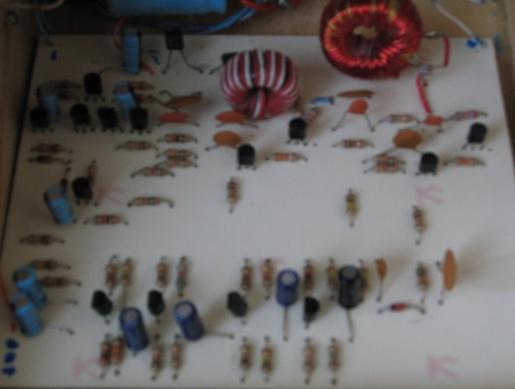
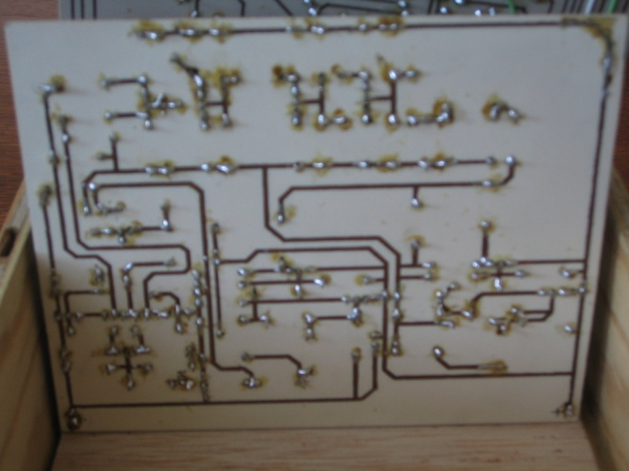
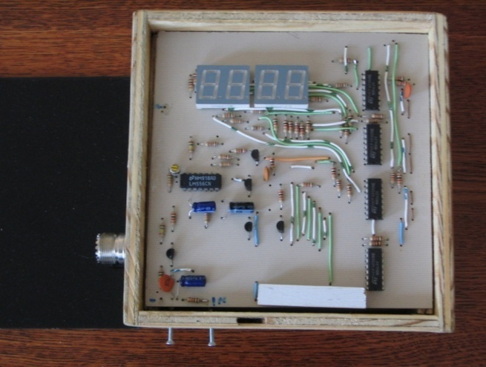
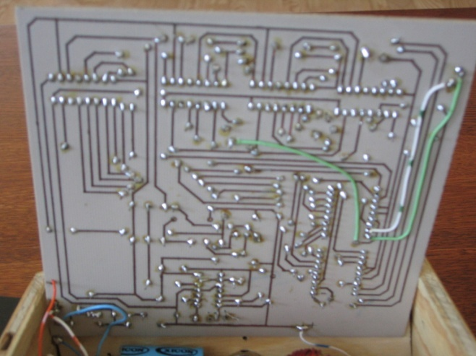
As-Built Images

Slide 44
References
ARRL Handbook 2005 Edition
Receiver Test and Troubleshooting 1950s
Art of Electronics
Digital design cookbook
Tektronix Digital Guide
The Book: A guide to the Digital Transition

Slide 45
Questions ??????

