Slide 1

EE482: Digital Signal Processing Applications
Audio Signal Processing

Slide 2
Outline
Audio Coding
Audio Equalizers
Audio Effects

Slide 3
Audio Signal Processing
Digital audio processing used in many consumer electronics
  Mp3 players, televisions, etc.
CD audio format:
  16-bit PCM @ 44.1Khz → stereo 1411.2 kbps
  Great for uncompressed CD-quality sound
  Not well-suited for modern media consumption
    Uncompressed storage and transmission
    Multi-channel audio (e.g. surround sound systems)
    “Professional” audio high sampling rate (96 kHz)
Techniques are required to enable high quality sound reproduction efficiently

Slide 4
Audio Coding
Differences with speech
  Much wider bandwidth (not just 300-1000 Hz)
  Uses multiple channels
  Psychoacoustic principles can be utilized for coding
    Do not code frequency components below hearing threshold
Lossy compression used based on noise shaping
  Noise below masking threshold is not audible
Entropy coding applied
  Large amount of data from high sampling rate and multi-channels

Slide 5
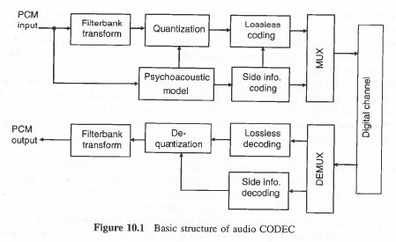
Audio Codec
Codec = coder-decoder
Filterbank transform
  Convert between full-band signal (all frequencies) into subbands (modified discrete cosine transform MDCT)
Psychoacoustic model
  Calculates thresholds according to human masking effects and used for quantization of MDCT
Quantization
  MDCT coefficient quantization of spectral coefficients
Lossless coding
  Use entropy coding to reduce redundancy of coded bitstream
Side information coding
  Bit allocation information
Multiplexer
  Pack all coded bits into bitstream

Slide 6

Encoded Bit Stream
Header
  Contains frame format information and synchronization word (e.g. bit rate, sampling frequency, etc.)
CRC – cyclic redundancy check
  Error detection code to protect the header
Side information
  Decoder information (parameters)
Main data
  Coded spectral coefficients and lossless encoded data
Ancillary information
  User defined info (e.g. track title, album, etc.)

Slide 7
Auditory Masking Effects
Psychoacoustic principle that a low-level signal (maskee) becomes inaudible when a louder signal (masker) occurs simultaneously
Human hearing does not respond equally to all frequency components
Auditory masking depends on the spectral distribution of masker and maskee
  These will vary in time
Will do noise shaping during encoding to exploit human hearing

Slide 8
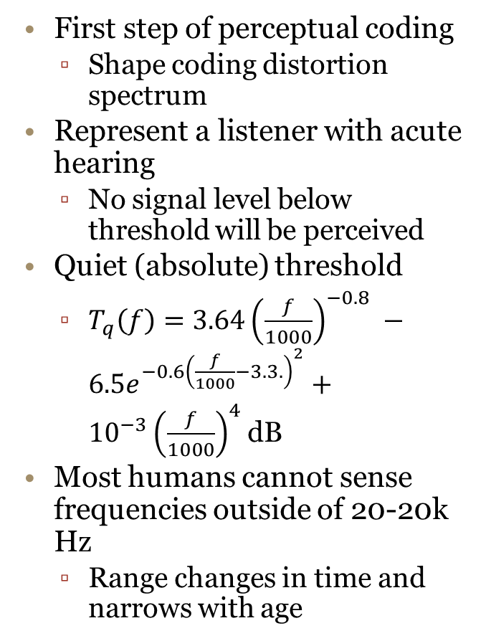
Quiet Threshold
First step of perceptual coding
  Shape coding distortion spectrum
Represent a listener with acute hearing
  No signal level below threshold will be perceived
Quiet (absolute) threshold
  $T_{q}\left(f\right)=3.64{\left(\frac{f}{1000}\right)}^{−0.8} −6.5e^{−0.6{\left(\frac{f}{1000}−3.3.\right)}^{2}}+{10}^{−3}{\left(\frac{f}{1000}\right)}^{4}$dB
Most humans cannot sense frequencies outside of 20-20k Hz
  Range changes in time and narrows with age

Slide 9
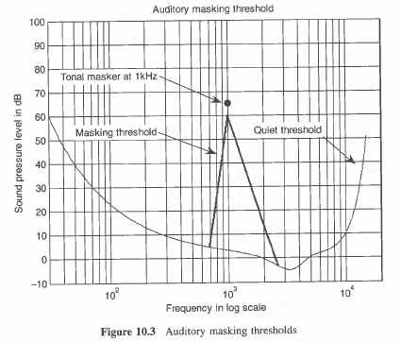
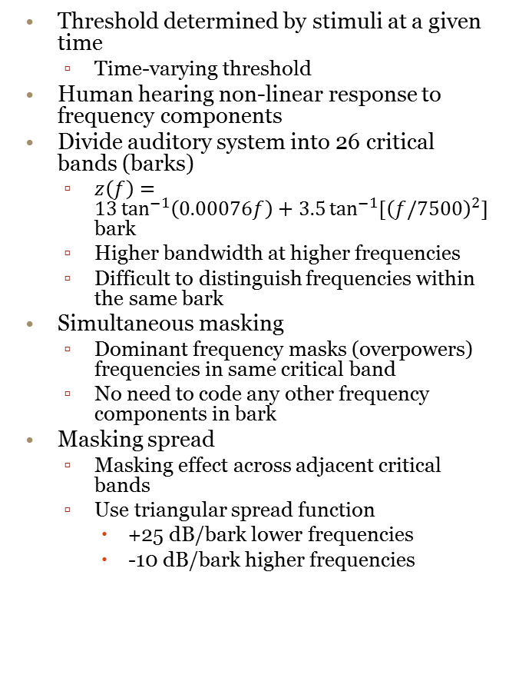
Masking Threshold
Threshold determined by stimuli at a given time
  Time-varying threshold
Human hearing non-linear response to frequency components
Divide auditory system into 26 critical bands (barks)
  $z\left(f\right)=13\tan^{−1}\left(0.00076f\right)+3.5\tan^{−1}{[{\left(f/7500\right)}^{2}]}$ bark
  Higher bandwidth at higher frequencies
  Difficult to distinguish frequencies within the same bark
Simultaneous masking
  Dominant frequency masks (overpowers) frequencies in same critical band
  No need to code any other frequency components in bark
Masking spread
  Masking effect across adjacent critical bands
  Use triangular spread function
    +25 dB/bark lower frequencies
    -10 dB/bark higher frequencies

Slide 10
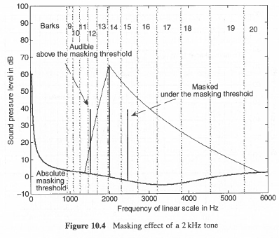
Example 10.1
Masking with multiple tones
  65 dB tone at 2kHz
  40 dB tone at 1.5 and 2.5 kHz
Use quiet threshold first
  All pass absolute threshold
Using masking threshold
  65 dB tone is dominant
Simultaneous masking
  Examine barks (no overlap)
Masking spread
  2.5 kHz masked
  1.5 kHz needs to be coded

Slide 11
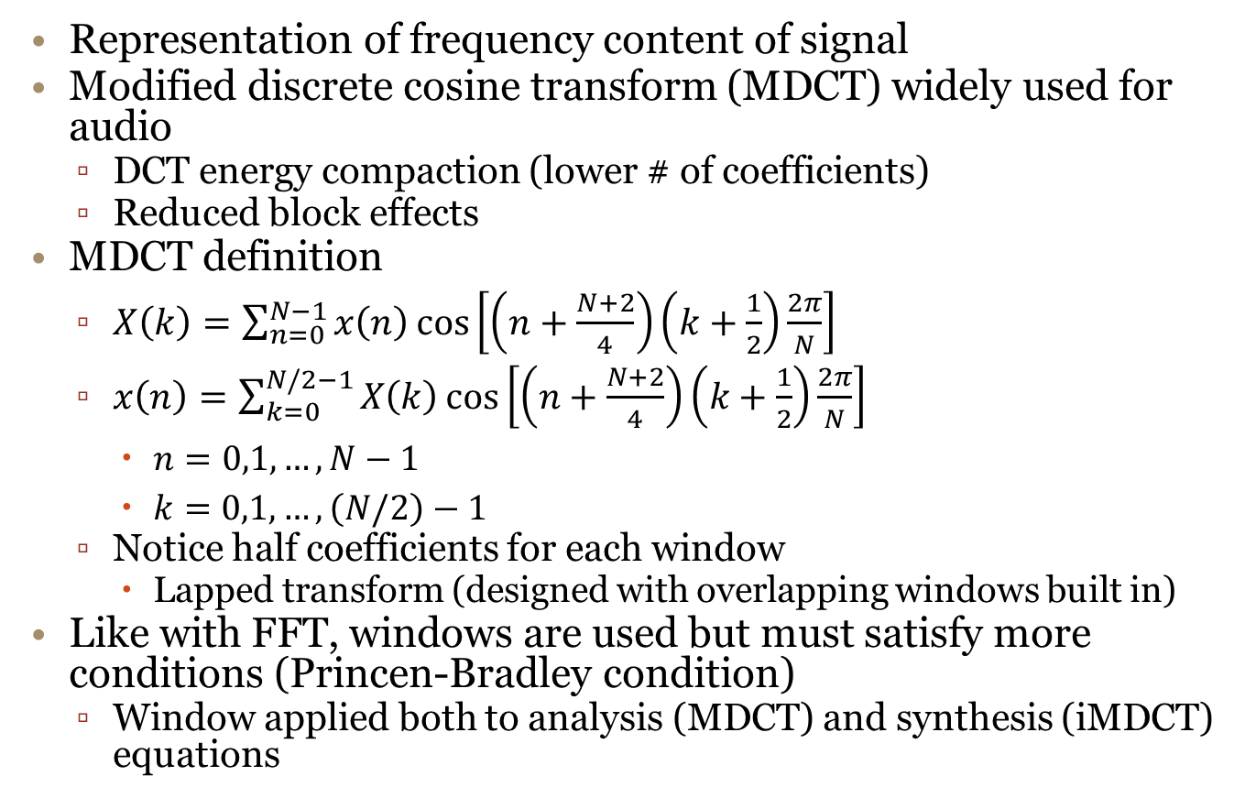
Frequency Domain Coding
Representation of frequency content of signal
Modified discrete cosine transform (MDCT) widely used for audio
  DCT energy compaction (lower # of coefficients)
  Reduced block effects
MDCT definition
  $X\left(k\right)=\sum_{n=0}^{N−1}{x\left(n\right)\cos\left[\left(n+\frac{N+2}{4}\right)\left(k+\frac{1}{2}\right)\frac{2π}{N}\right]}$
  $x\left(n\right)=\sum_{k=0}^{N/2−1}{X\left(k\right)\cos\left[\left(n+\frac{N+2}{4}\right)\left(k+\frac{1}{2}\right)\frac{2π}{N}\right]}$
    $n=0,1, …,N−1$
    $k=0,1,…, \left(N/2\right)−1$
  Notice half coefficients for each window
    Lapped transform (designed with overlapping windows built in)
Like with FFT, windows are used but must satisfy more conditions (Princen-Bradley condition)
  Window applied both to analysis (MDCT) and synthesis (iMDCT) equations

Slide 12
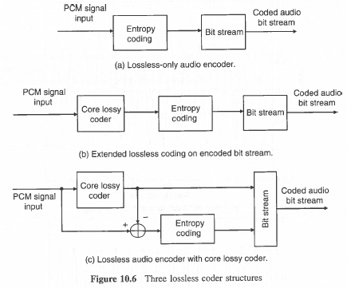
Audio Coding
Entropy (lossless) coding removes redundancy in coded data without loss in quality
Pure entropy coding (lossless-only)
  Huffman encoding – statistical coding
    More often occurring symbols have shorter code words
    Fast method using a lookup table
  Cannot achieve very high compression
Extended lossless coding
  Lossy coder followed by entropy coding
  20% compression gain
    MP3 – perceptual coding followed by entropy coding
Scalable lossless coding
  Can have perfect reproduction
  Input first encoded, residual error is entropy coded
  Results in two bit streams
    Can choose lossy lowbit rate and combine for high quality lossless

Slide 13
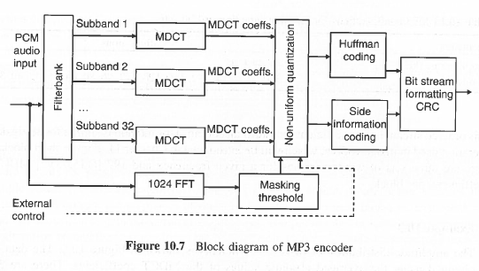
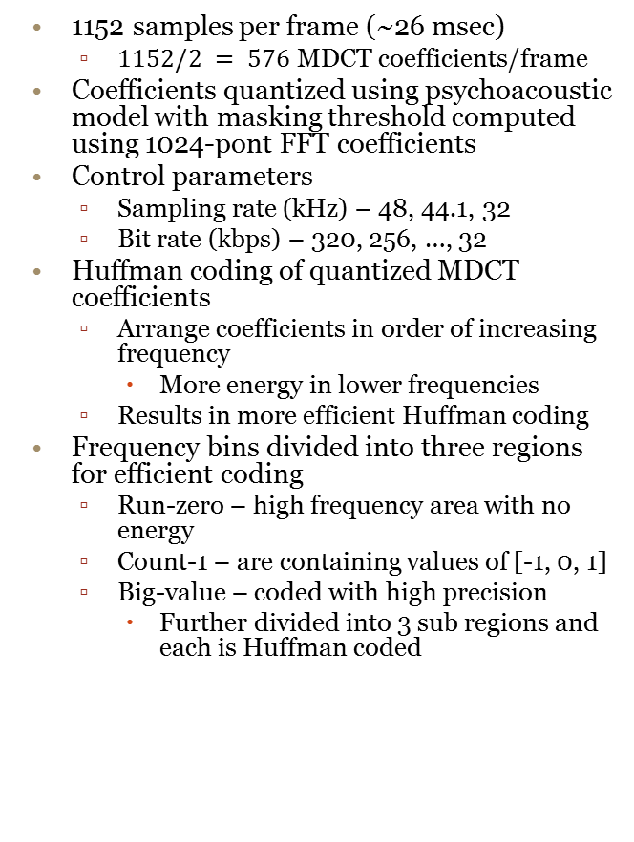
MP3 Algorithm
Filterbank splits audio into 32 subbands
  Each decimated to 32-36 MDCT coefficients
  32 x 36 = 1152 samples per frame
Each band processed separately
  MDCT block length of 18 and 6
    Requires windows of 36 and 12 for 50% overlap
  Longer blocks give better frequency resolution (stationary signals)
  Shorter block length for better time resolution during transients
1152 samples per frame (~26 msec)
  $1152/2 = 576$ MDCT coefficients/frame
Coefficients quantized using psychoacoustic model with masking threshold computed using 1024-pont FFT coefficients
Control parameters
  Sampling rate (kHz) – 48, 44.1, 32
  Bit rate (kbps) – 320, 256, …, 32
Huffman coding of quantized MDCT coefficients
  Arrange coefficients in order of increasing frequency
    More energy in lower frequencies
  Results in more efficient Huffman coding
Frequency bins divided into three regions for efficient coding
  Run-zero – high frequency area with no energy
  Count-1 – are containing values of [-1, 0, 1]
  Big-value – coded with high precision
    Further divided into 3 sub regions and each is Huffman coded

Slide 14
Audio Equalizers
Spectral equalization uses filtering techniques to reshape magnitude spectrum
  Useful for recording and reproduction
Example uses
  Simple filters to adjust bass and treble
  Correct response of microphone, instrument pick-ups, loudspeakers, and hall acoustics
Parametric equalizers provide better frequency compensations but require more operator knowledge than graphic equalizers

Slide 15
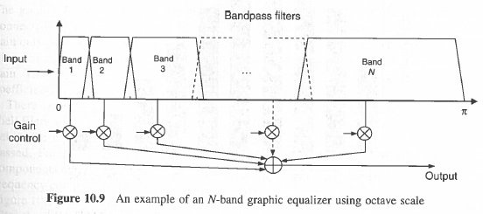
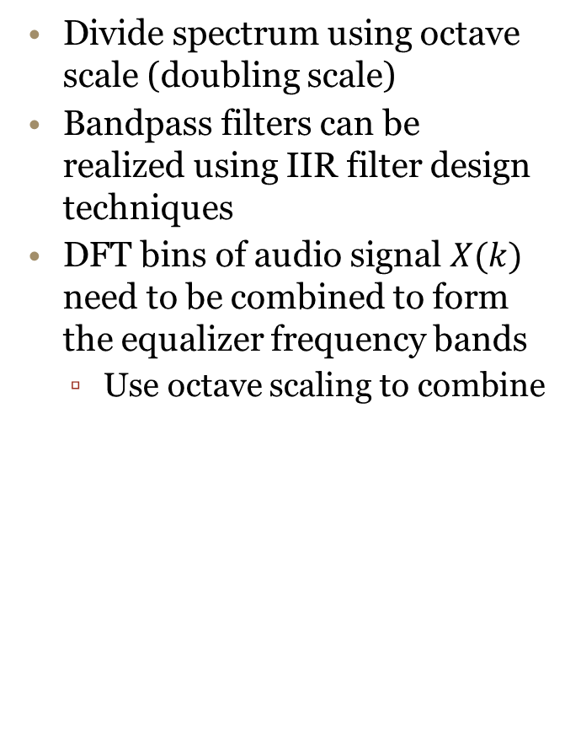
Graphic Equalizers
Use of several frequency bands to display and adjust the power of audio frequency components
Input signal decomposed with bank of parallel bandpass filters
Separate gain control for each band
Signal power in each band estimated and displayed graphically with a bar
Divide spectrum using octave scale (doubling scale)
Bandpass filters can be realized using IIR filter design techniques
DFT bins of audio signal $X(k)$ need to be combined to form the equalizer frequency bands
  Use octave scaling to combine

Slide 16
Example 10.4
Graphic equalizer to adjust signal
Select bands
  Use octave scaling
  bandFreqs = {'31.25','62.5','125','250','500','1k','2k','4k','8k','16k'};

Slide 17
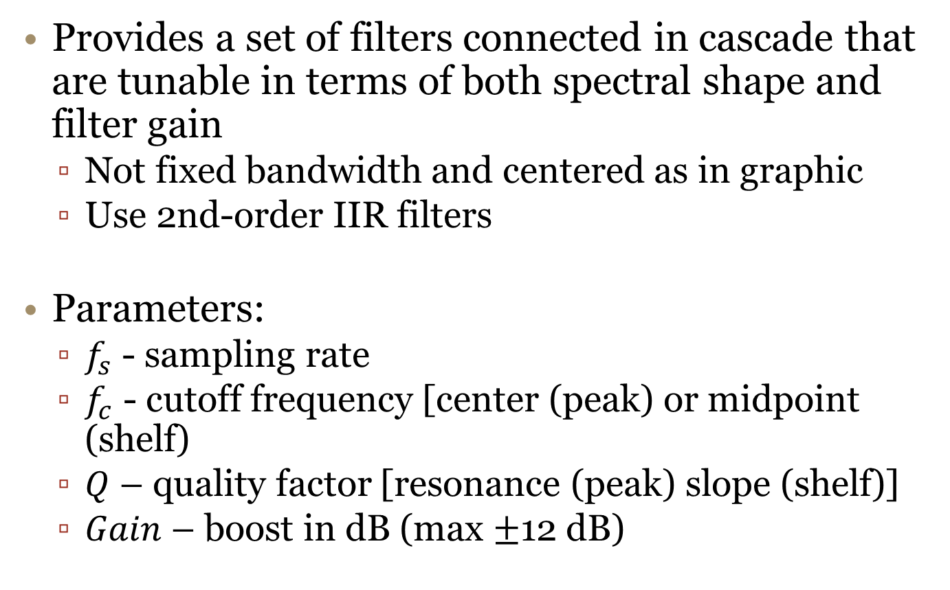
Parametric Equalizers
Provides a set of filters connected in cascade that are tunable in terms of both spectral shape and filter gain
  Not fixed bandwidth and centered as in graphic
  Use 2nd-order IIR filters
Parameters:
  $f_{s}$ - sampling rate
  $f_{c}$ - cutoff frequency [center (peak) or midpoint (shelf)
  $Q$ – quality factor [resonance (peak) slope (shelf)]
  $Gain$ – boost in dB (max $±$12 dB)

Slide 18
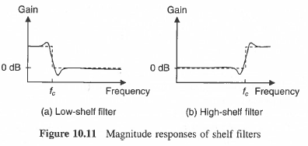
Shelf Filters
Low-shelf
  Boost frequencies below cuttoff and pass higher components
High-shelf
  Boost frequencies above cuttoff and pass rest
See book for equations
Ex 10.6
  Shape of shelf filter with different gain parameters

Slide 19
Peak Filter
Peak filter – amplify certain narrow frequency bands
Notch filter – attenuate certain narrow frequency bands
E.g. loudness of certain frequency
See book for equations
Ex 10.5
  Shape of peak filter for different parameters

Slide 20
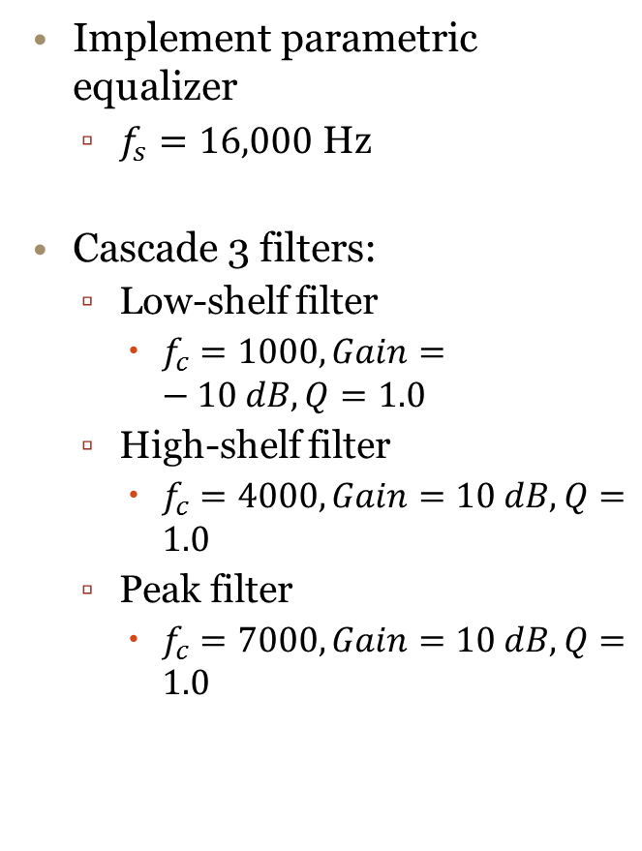
Example 10.7
Implement parametric equalizer
  $f_{s}=16,000$ Hz
Cascade 3 filters:
  Low-shelf filter
    $f_{c}=1000, Gain=−10 dB, Q=1.0$
  High-shelf filter
    $f_{c}=4000, Gain=10 dB, Q=1.0$
  Peak filter
    $f_{c}=7000, Gain=10 dB, Q=1.0$
Play example file outside of powerpoint
  Left channel – original signal
  Right channel - filtered

Slide 21
Audio (Sound) Effects
Use of filtering techniques to emphasize audio signal in “artistic” manner
Will only mention and give examples of some common effects
  Not an in-depth look

Slide 22
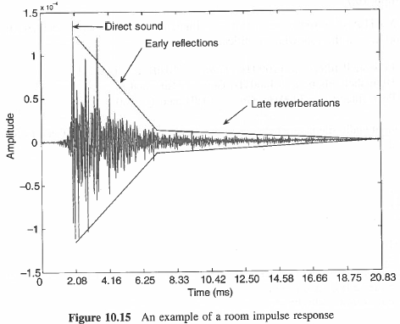
Sound Reverberation
Reverberation is echo sound from reflected sounds
The echoes are related to the physical properties of the space
  Room size, configuration, furniture, etc.
Use impulse response to measure
Direct sound
  First sound wave to reach ear
Reflected sound
  The echo waves that arrive after bouncing off a surface
Example 10.8
Use hall impulse response to simulated reverberated sound
Input
Output

Slide 23
Pitch Shift
Change speech pitch (fundamental frequency)
All frequencies are adjusted over the entire signal
  Chipmunk voice
Example 10.9a
  Adjust pitch
See audio files
original
pitch shifted

Slide 24
Time Stretch
Change speed of audio playback without affecting pitch
Audio editing: adjust audio to fit a specific timeline
Example 10.9b
  Adjust play time
See audio files

Slide 25
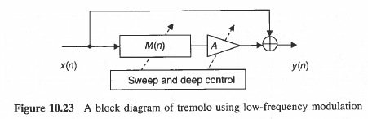

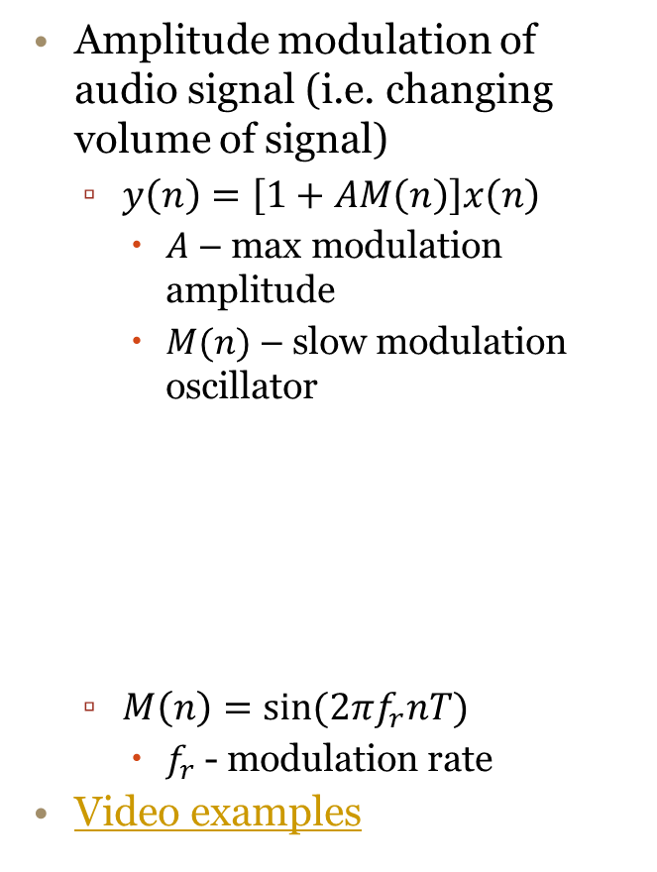
Tremolo
Amplitude modulation of audio signal (i.e. changing volume of signal)
  $y\left(n\right)=\left[1+AM\left(n\right)\right]x\left(n\right)$
    $A$ – max modulation amplitude
    $M(n)$ – slow modulation oscillator
  $M\left(n\right)=\sin{(2πf_{r}nT)}$
    $f_{r}$ - modulation rate
Video examples
Example 10.10
  $A=1, f_{r}=1 Hz$
  White noise input at $f_{s}=8000 Hz$

Slide 26
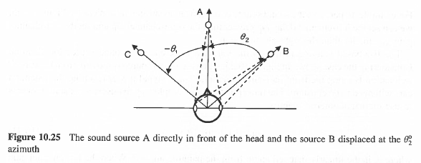
Spatial Sounds
Audio source localization determined by the way it is perceived by human ears
  Time delay and intensity differences
Sounds in different positions arrive differently at ears
  Interaural time difference (ITD) - delay between sounds reaching ear for localization
  Iteraural intensity difference (IID) - loudness difference for localization
Binaural audio demos
  Great home fun → use headphones
  Virtual Barbershop
  Jeff’s Favorite Things
  QSoundLab
  Adventures in 3D Sound!

