Slide 1

EE360: Signals and System I
Chapter 9
Laplace Transform

Slide 2
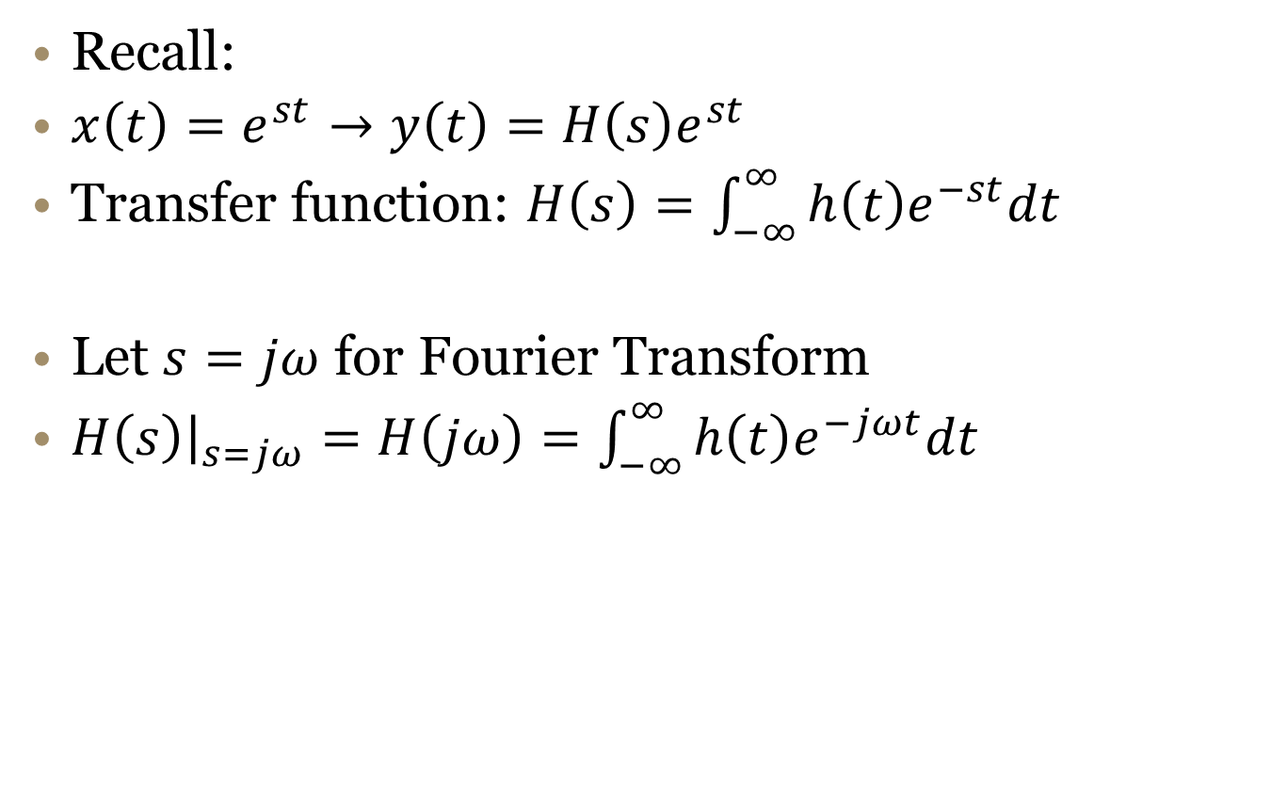
LTI Eigensignals
Recall:
$x\left(t\right)=e^{st}→y\left(t\right)=H\left(s\right)e^{st}$
Transfer function: $H\left(s\right)=\int_{−∞}^{∞}{h\left(t\right)e^{−st}dt }$
Let $s=jω$ for Fourier Transform
$H\left(s\right){\left.​\right|}_{s=jω}=H\left(jω\right)=\int_{−∞}^{∞}{h\left(t\right)e^{−jωt}dt}$

Slide 3

Laplace Transform
Define LP for $s=σ+jω∈ℂ$
$X\left(s\right)≜\int_{−∞}^{∞}{x\left(t\right)e^{−st}dt}$
Notation:
$X\left(s\right)=ℒ\{x\left(t\right)\}$
$x(t)⟷X(s)$

Slide 4
Laplace Transform Tables
Last time, we computed the LT directly from the integral definition
  Learned that there is an algebraic form for LT as well as the region of convergence (ROC)
  Both are needed to uniquely identify the LT
More often, we will use tables of known transform pairs (Table 9.2) and transform properties (Table 9.1).

Slide 5
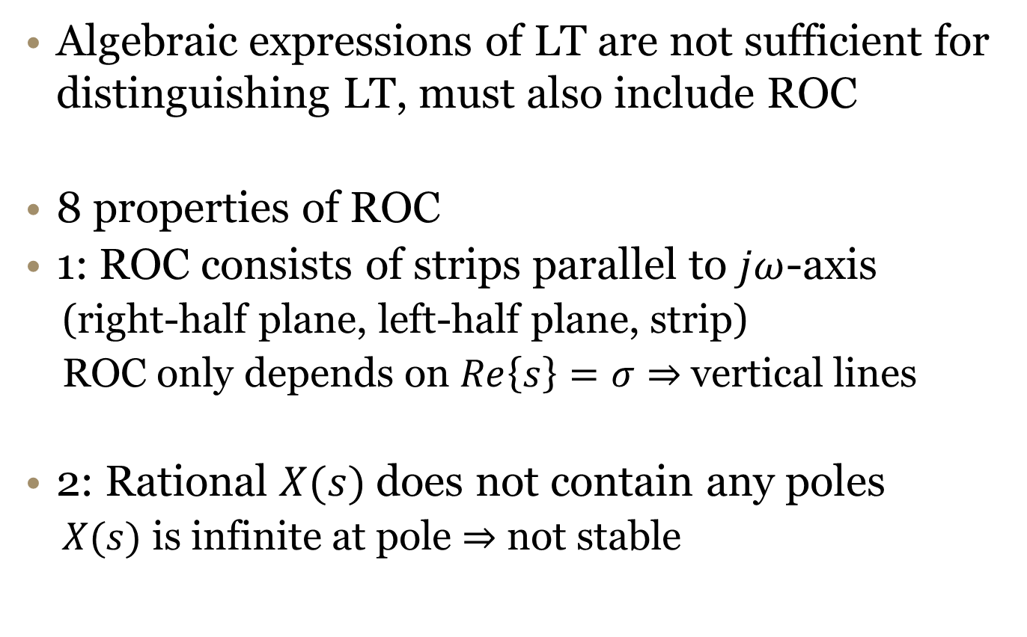
ROC for Laplace Transform
Algebraic expressions of LT are not sufficient for distinguishing LT, must also include ROC
8 properties of ROC
1: ROC consists of strips parallel to $jω$-axis
  (right-half plane, left-half plane, strip)
  ROC only depends on $Re\left\{s\right\}=σ⇒$ vertical lines
2: Rational $X(s)$ does not contain any poles
  $X(s)$ is infinite at pole $⇒$ not stable

Slide 6
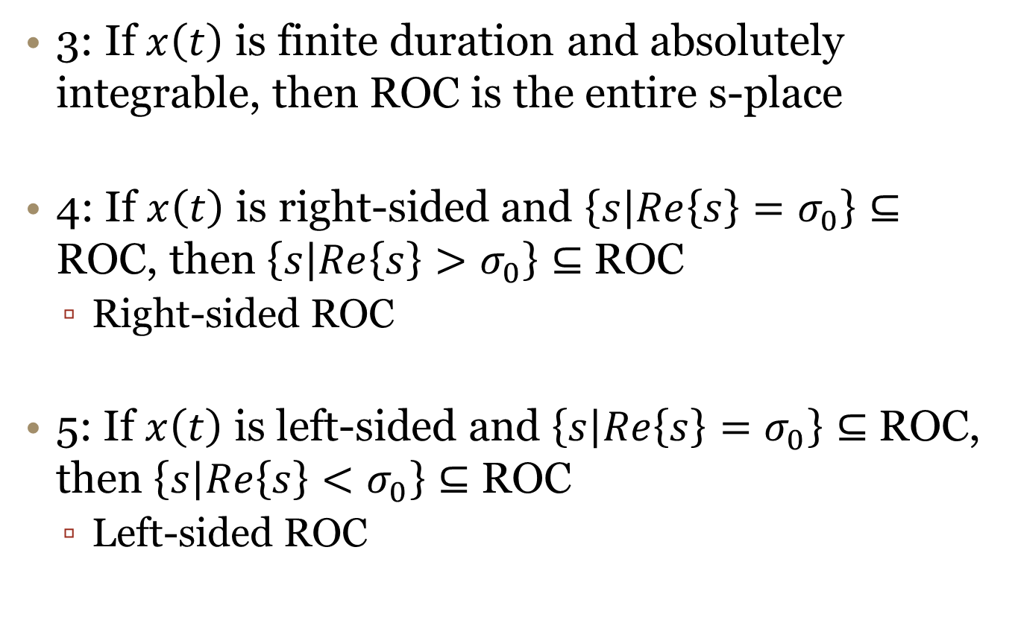
ROC for Laplace Transform II
3: If $x\left(t\right)$ is finite duration and absolutely integrable, then ROC is the entire s-place
4: If $x\left(t\right)$ is right-sided and $\left\{s | Re\left\{s\right\}=σ_{0}\right\}⊆$ ROC, then $\left\{s | Re\left\{s\right\}>σ_{0}\right\}⊆$ ROC
  Right-sided ROC
5: If $x\left(t\right)$ is left-sided and $\left\{s | Re\left\{s\right\}=σ_{0}\right\}⊆$ ROC, then $\left\{s | Re\left\{s\right\}<σ_{0}\right\}⊆$ ROC
  Left-sided ROC

Slide 7
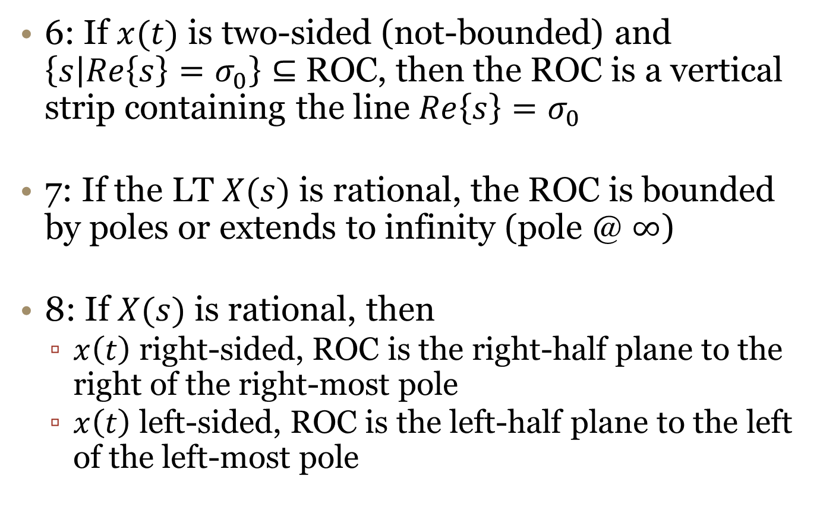
ROC for Laplace Transform III
6: If $x(t)$ is two-sided (not-bounded) and $\left\{s | Re\left\{s\right\}=σ_{0}\right\}⊆$ ROC, then the ROC is a vertical strip containing the line $Re\left\{s\right\}=σ_{0}$
7: If the LT $X(s)$ is rational, the ROC is bounded by poles or extends to infinity (pole @ $∞$)
8: If $X(s)$ is rational, then
  $x\left(t\right)$ right-sided, ROC is the right-half plane to the right of the right-most pole
  $x\left(t\right)$ left-sided, ROC is the left-half plane to the left of the left-most pole

Slide 8

Example ROC Properties
$X\left(s\right)=\frac{1}{(s+1)(s+2)}$

Slide 9
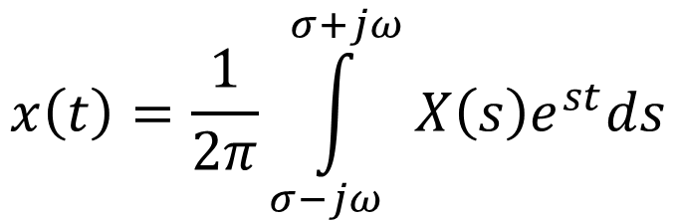
Inverse LT
By using inverse FT we can find the definition of the inverse LT
  The synthesis equation is a weighted sum of complex exponentials
Note: this is a contour integral along any vertical line in the ROC of s-plane!
  We won’t do it this way, instead will rely on PFE techniques in lookup tables
$$x\left(t\right)=\frac{1}{2π}\int_{σ−jω}^{σ+jω}{X\left(s\right)e^{st}ds}$$

Slide 10
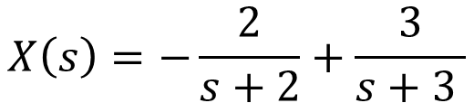
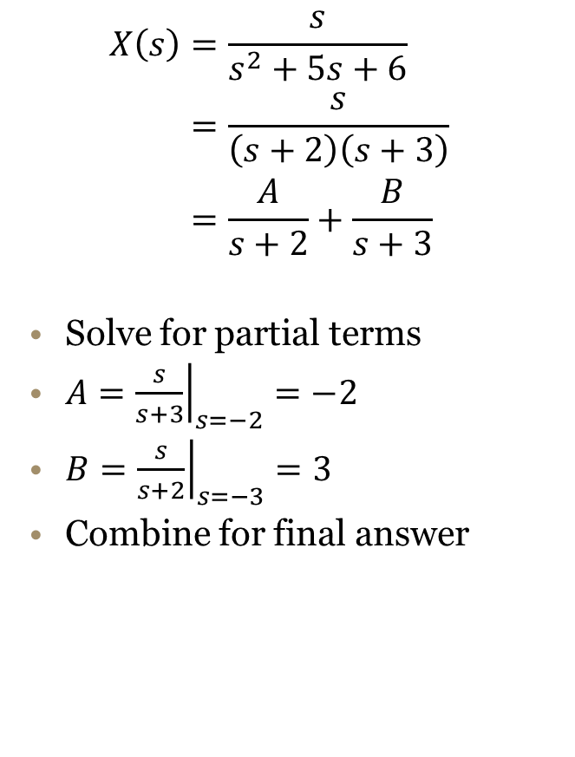
Example Inverse LT
$$\begin{aligned}X\left(s\right)&=\frac{s}{s^{2}+5s+6} \\ &=\frac{s}{\left(s+2\right)\left(s+3\right)} \\ &=\frac{A}{s+2}+\frac{B}{s+3}\end{aligned}$$
Solve for partial terms
$A={\left.\frac{s}{s+3}\right|}_{s=−2}=−2$
$B={\left.\frac{s}{s+2}\right|}_{s=−3}=3$
Combine for final answer
What are the possible ROC’s?
$$X\left(s\right)=−\frac{2}{s+2}+\frac{3}{s+3 }$$

Slide 11
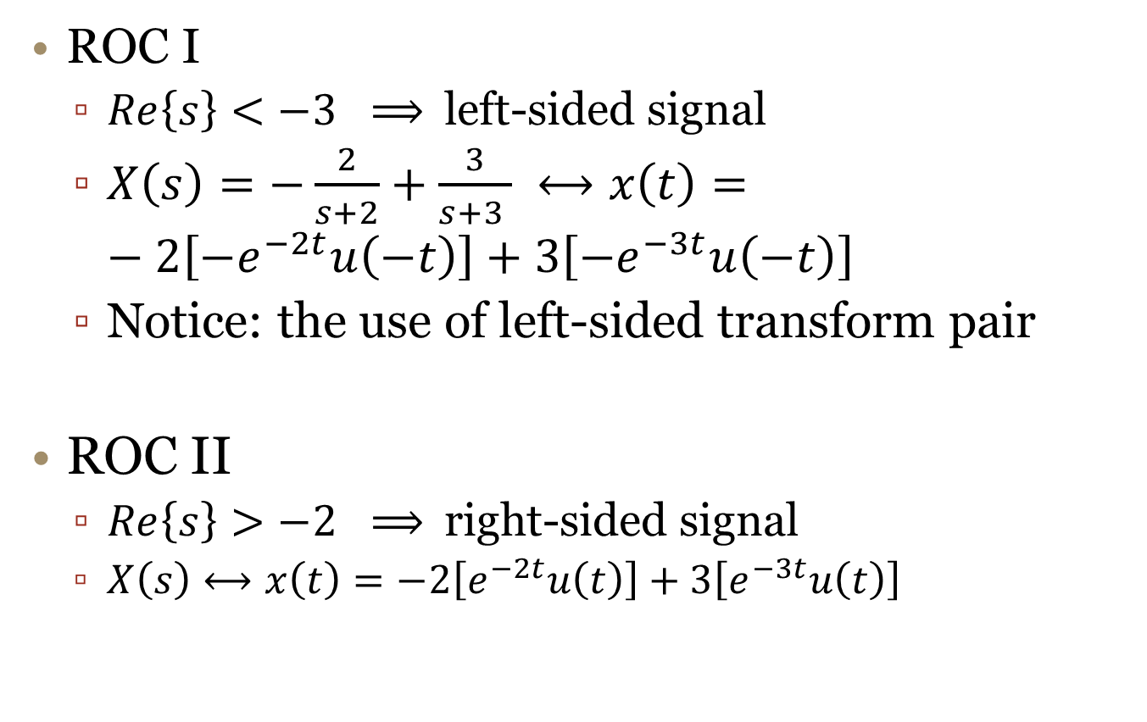
Example Inverse LT II
ROC I
  $Re\left\{s\right\}<−3 ⟹$left-sided signal
  $X\left(s\right)=−\frac{2}{s+2}+\frac{3}{s+3 } ⟷x\left(t\right)=−2\left[−e^{−2t}u\left(−t\right)\right]+3\left[−e^{−3t}u\left(−t\right)\right]$
  Notice: the use of left-sided transform pair
ROC II
  $Re\left\{s\right\}>−2 ⟹$right-sided signal
  $X\left(s\right)⟷x\left(t\right)=−2\left[e^{−2t}u\left(t\right)\right]+3\left[e^{−3t}u\left(t\right)\right]$

Slide 12
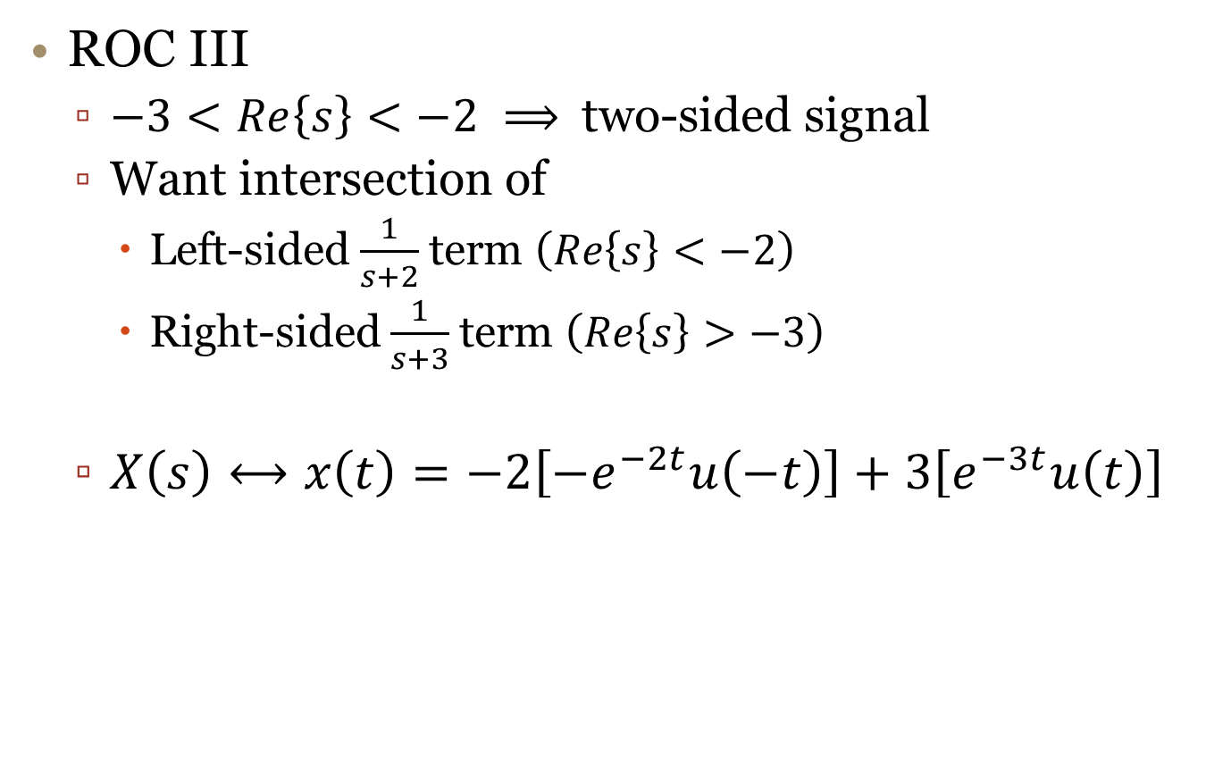
Example Inverse LT III
ROC III
  $−3<Re\left\{s\right\}<−2 ⟹$two-sided signal
  Want intersection of
    Left-sided $\frac{1}{s+2}$term $\left(Re\left\{s\right\}<−2\right)$
    Right-sided $\frac{1}{s+3}$term $\left(Re\left\{s\right\}>−3\right)$
  $X\left(s\right)⟷x\left(t\right)=−2\left[−e^{−2t}u\left(−t\right)\right]+3\left[e^{−3t}u\left(t\right)\right]$
Left-sided
Right-sided

Slide 13
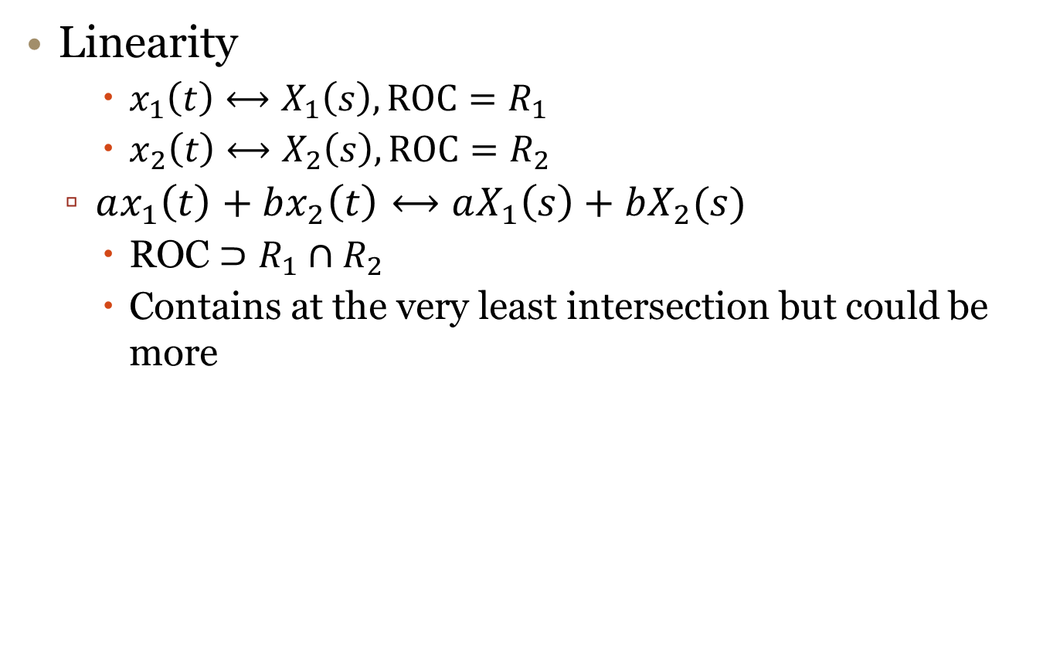
Properties of LT (Table 9.1)
Linearity
    $x_{1}\left(t\right)⟷X_{1}\left(s\right), \text{ROC}=R_{1}$
    $x_{2}\left(t\right)⟷X_{2}\left(s\right), \text{ROC}=R_{2}$
  $ax_{1}\left(t\right)+bx_{2}\left(t\right)⟷aX_{1}\left(s\right)+bX_{2}(s)$
    ROC $⊃R_{1}∩R_{2}$
    Contains at the very least intersection but could be more

Slide 14
Linearity Example

Slide 15
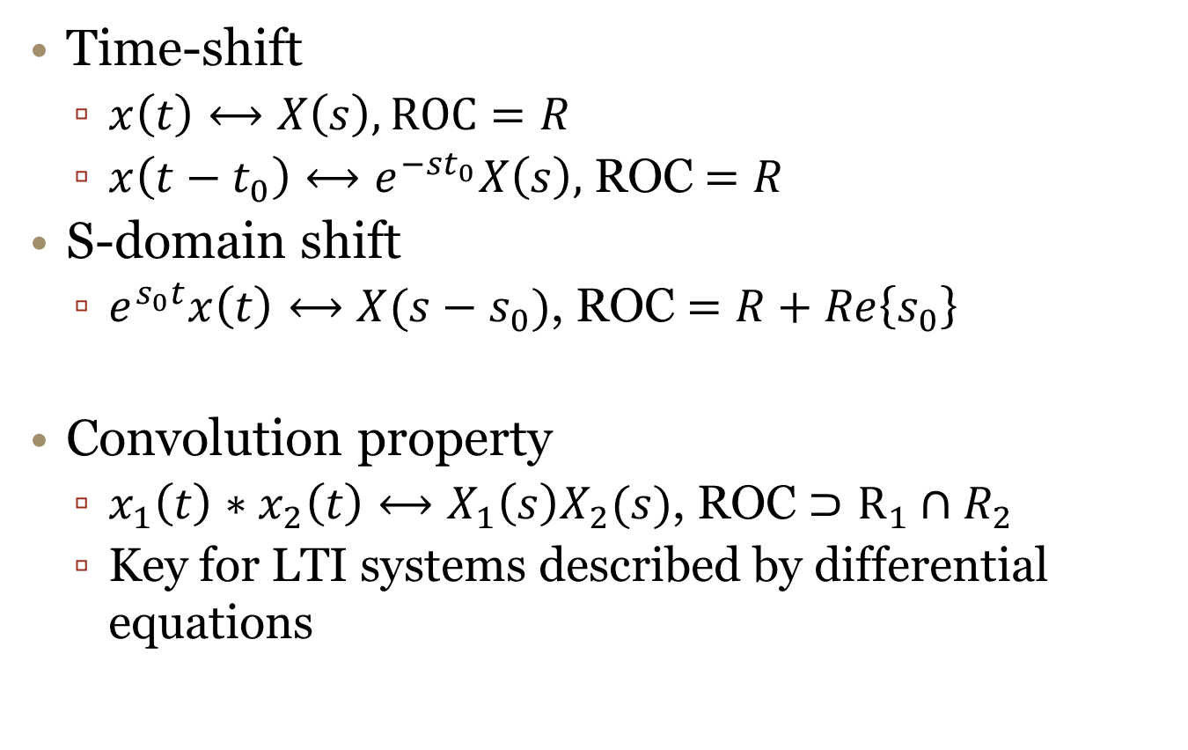
Properties of LT II
Time-shift
  $x\left(t\right)⟷X\left(s\right), \text{ROC}=R$
  $x\left(t−t_{0}\right)⟷e^{−st_{0}}X\left(s\right),$ROC$=R$
S-domain shift
  $e^{s_{0}t}x\left(t\right)⟷X(s−s_{0})$, ROC $=R+Re\left\{s_{0}\right\}$
Convolution property
  $x_{1}\left(t\right)∗x_{2}\left(t\right)⟷X_{1}\left(s\right)X_{2}(s)$, ROC $⊃R_{1}∩R_{2}$
  Key for LTI systems described by differential equations

Slide 16
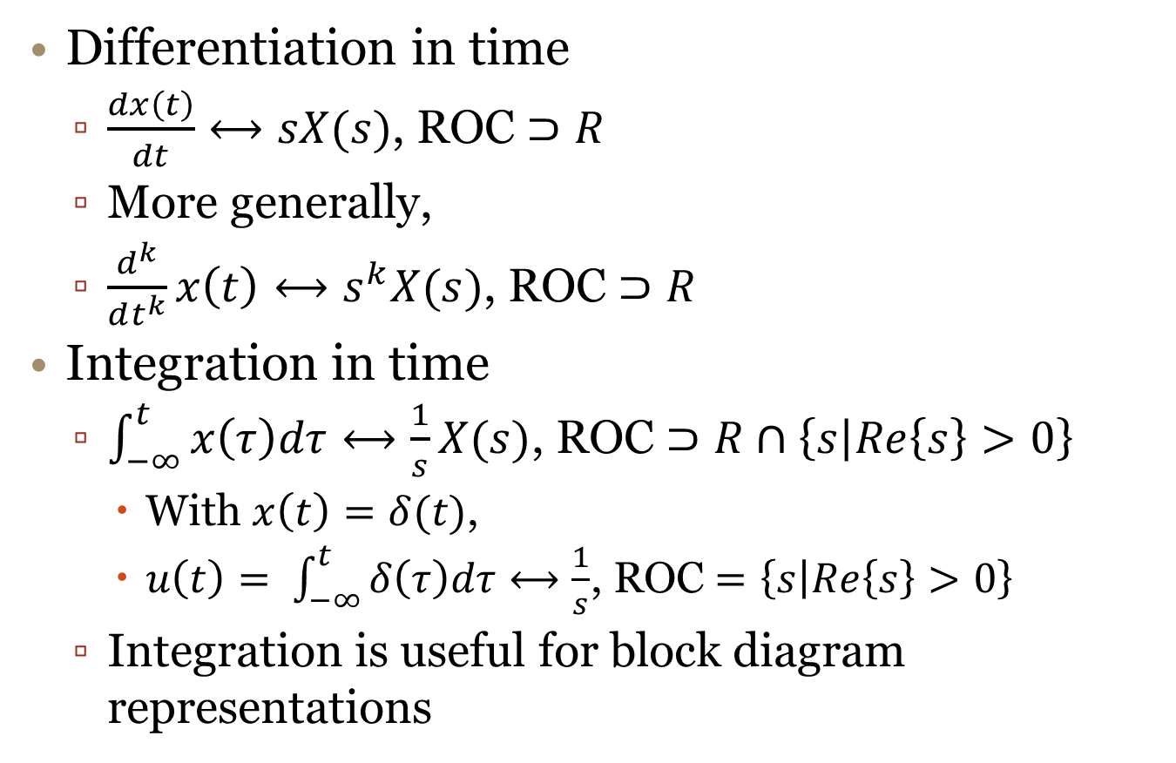
Properties of LT III
Differentiation in time
  $\frac{dx\left(t\right)}{dt}⟷sX(s)$, ROC $⊃R$
  More generally,
  $\frac{d^{k}}{dt^{k}}x\left(t\right)⟷s^{k}X(s)$, ROC $⊃R$
Integration in time
  $\int_{−∞}^{t}{x\left(τ\right)dτ}⟷\frac{1}{s}X(s)$, ROC $⊃R∩\left\{s | Re\left\{s\right\}>0\right\}$
    With $x\left(t\right)=δ(t)$,
    $u\left(t\right)= \int_{−∞}^{t}{δ\left(τ\right)dτ}⟷\frac{1}{s}$, ROC $=\left\{s | Re\left\{s\right\}>0\right\}$
  Integration is useful for block diagram representations

Slide 17
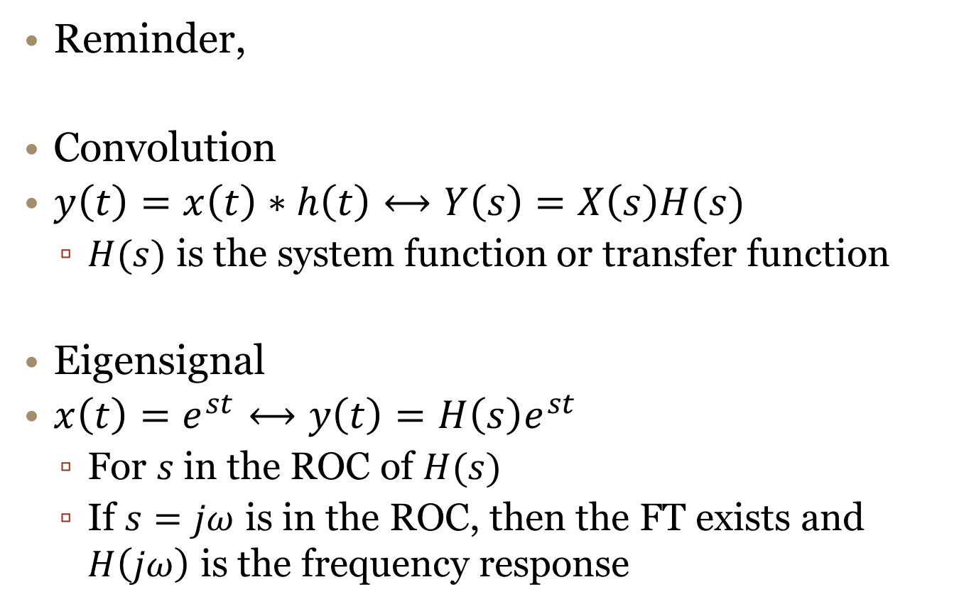
LTI Systems and LT
Reminder,
Convolution
$y\left(t\right)=x\left(t\right)∗h\left(t\right)⟷Y\left(s\right)=X\left(s\right)H(s)$
  $H(s)$ is the system function or transfer function
Eigensignal
$x\left(t\right)=e^{st}⟷y\left(t\right)=H\left(s\right)e^{st}$
  For $s$in the ROC of $H(s)$
  If $s=jω$ is in the ROC, then the FT exists and $H\left(jω\right)$ is the frequency response

Slide 18
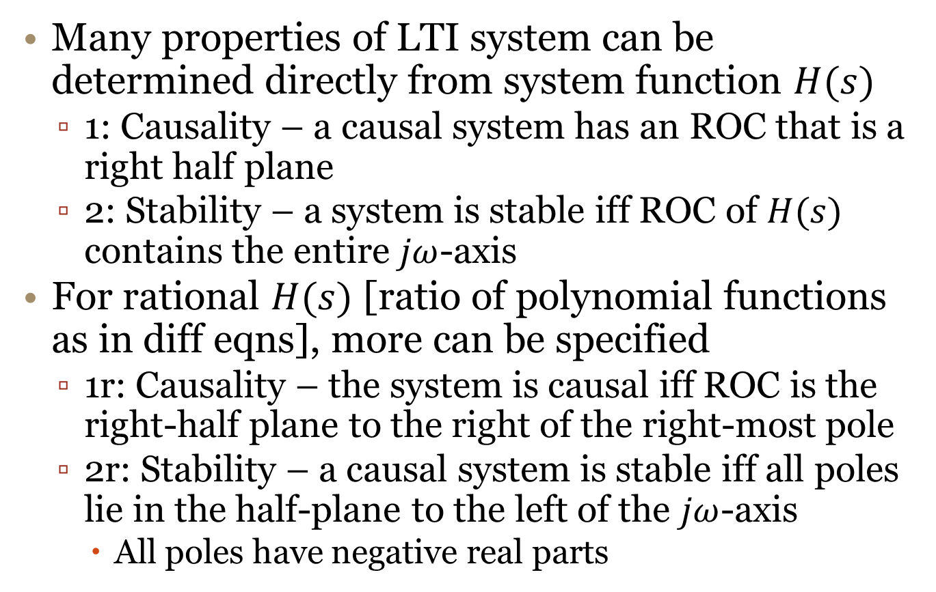

LTI System Properties from $H(s)$
Many properties of LTI system can be determined directly from system function $H(s)$
  1: Causality – a causal system has an ROC that is a right half plane
  2: Stability – a system is stable iff ROC of $H(s)$ contains the entire $jω$-axis
For rational $H(s)$ [ratio of polynomial functions as in diff eqns], more can be specified
  1r: Causality – the system is causal iff ROC is the right-half plane to the right of the right-most pole
  2r: Stability – a causal system is stable iff all poles lie in the half-plane to the left of the $jω$-axis
    All poles have negative real parts

Slide 19
Example

Slide 20
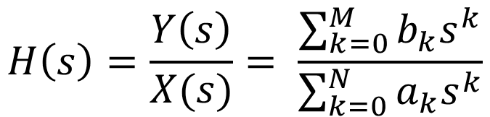
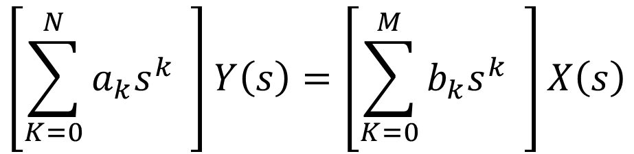
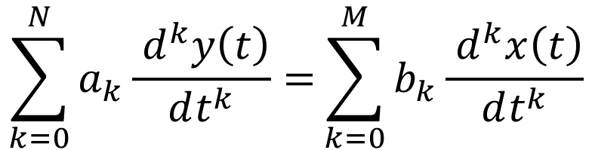
Differential Equation LTI Systems
Use differentiation in time-domain property
$$\sum_{k=0}^{N}{a_{k}\frac{{ d}^{k}y\left(t\right)}{dt^{k}}=}\sum_{k=0}^{M}{b_{k}\frac{{ d}^{k}x\left(t\right)}{dt^{k}}}$$
$$\left[\sum_{K=0}^{N}{a_{k}s^{k}} \right]Y\left(s\right)=\left[\sum_{K=0}^{M}{b_{k}s^{k}} \right]X\left(s\right)$$
$$H\left(s\right)=\frac{Y\left(s\right)}{X(s)}= \frac{\sum_{k=0}^{M}{b_{k}s^{k}}}{\sum_{k=0}^{N}{a_{k}s^{k}}}$$
Zeros
Poles

Slide 21
Example

