Slide 1
Road-Sign Detection and Recognition Based on Support Vector Machines
Saturnino, Sergio et al.
Yunjia Man
ECG 782 Dr. Brendan

Slide 2
Outline
1. Introduction
2. Detection and recognition system
    Segmentation
    Shape classification
    Recognition
3. Experimental results
4. Conclusions

Slide 3
1. Introduction
Road signs:
- regulate traffic
- indicate the state of the road
- color and shape
Common problems:
- variable lighting conditions
- possible rotation of the signs
- different dimensions of the signs
- occlusions (trees, other signs or vehicles)
- number of signs quite large

Slide 4
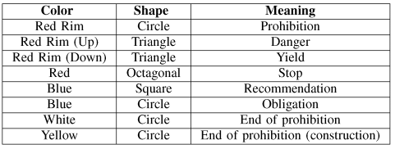
Aim of this paper:
- evaluate the signaling of road for maintenance purposes
- for future applications: driver-assistance systems
Meaning of Spanish traffic signs
Color: Red, Blue, Yellow, White
Shape: Circle, Triangle, Octagonal, Square

Slide 5
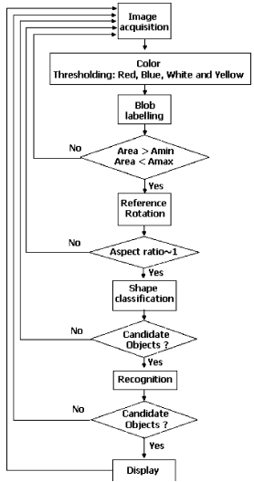
2. Road-sign detection and recognition system
Three stages:
Segmentation
color segmentation
analyze size, aspect ratio, rotate
Shape classification
distance to borders
Linear SVMs
Recognition
recognition of inner area
Gaussian kernel

Slide 6
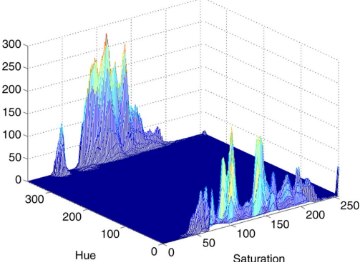
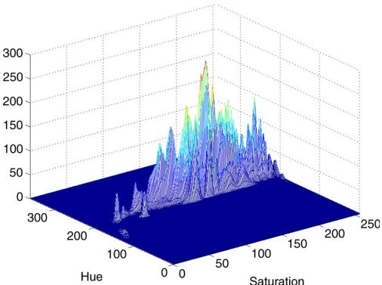
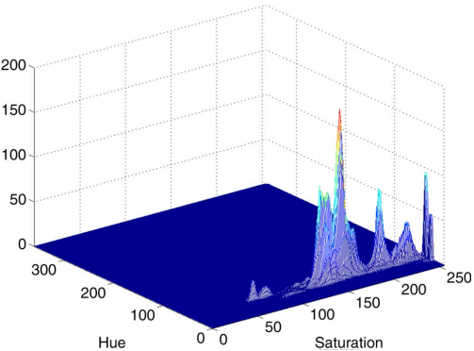
Segmentation
Threshold using HSI space to extract the sign color for chromatic signs
- Hue saturation intensity (HSI) space
- hue and saturation components with fixed thresholds
- hue-saturation histograms for red, blue, yellow of manually segmented signs
hue [0,360]; saturation [0,255]
Red
Blue
Yellow

Slide 7

Achromatic decomposition to detect white signs
- R, G, B: brightness of the respective color
- D: degree of extraction of an achromatic color D=20
- f(R,G,B)<1 achromatic colors; f(R,G,B)>1 chromatic colors
Traffic signs at night white signs
- vehicles’ headlamp illumination
- distribution of hue components similar to yellow signs
- saturation: difference between white and yellow

Slide 8
Two contributions: rim and inner region
- independent process
Blobs of interest (BoI) – possible traffic signs
- blobs: connected image pixels in the four color categories
- small and big blobs: noise and noninterest objects
- limit of size: between 1/20 and 2/3
- limit of aspect ratio: between 1/1.9 and 1.9
- corresponding bounding box: rectangle
- rotated to reference position

Slide 9
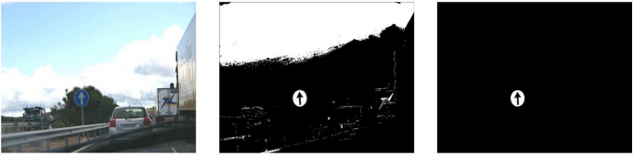
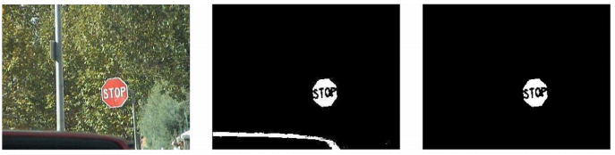
Original
Segmented
BoI

Slide 10
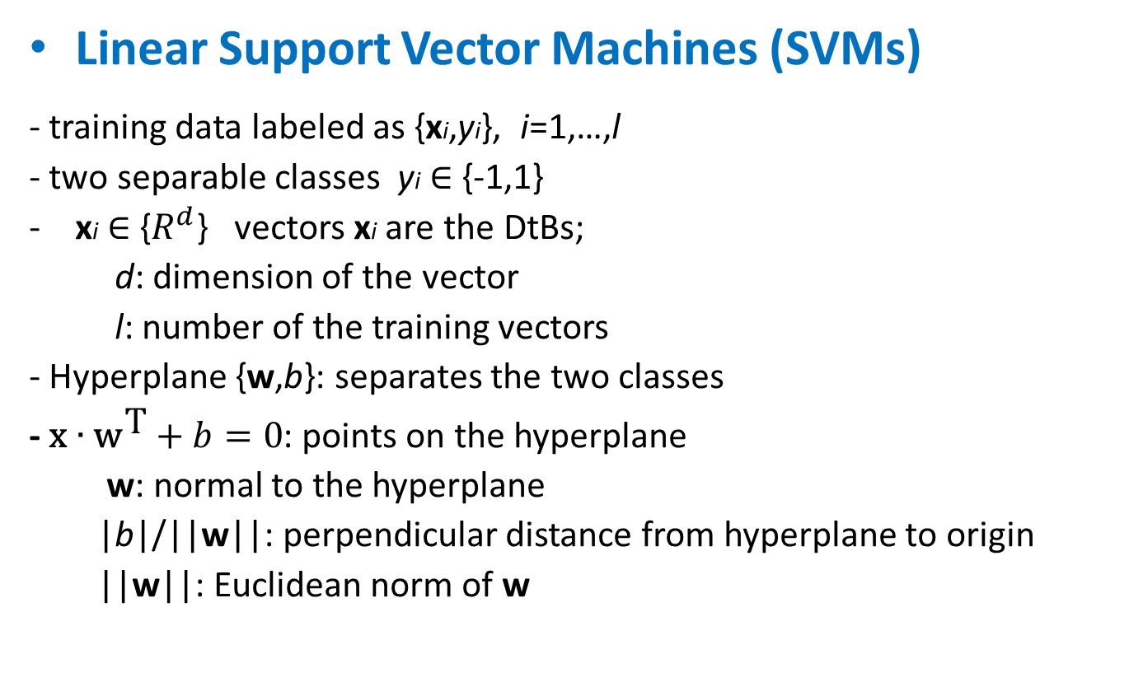
Shape classification
Linear Support Vector Machines (SVMs)
- training data labeled as {xi,yi}, i=1,…,l
- two separable classes yi ∈ {-1,1}
xi ∈ {$R^{d}$} vectors xi are the DtBs;
d: dimension of the vector
l: number of the training vectors
- Hyperplane {w,b}: separates the two classes
- $\text{x}∙{\text{w}}^{\text{T}}+b=0$: points on the hyperplane
w: normal to the hyperplane
|b|/||w||: perpendicular distance from hyperplane to origin
||w||: Euclidean norm of w

Slide 11




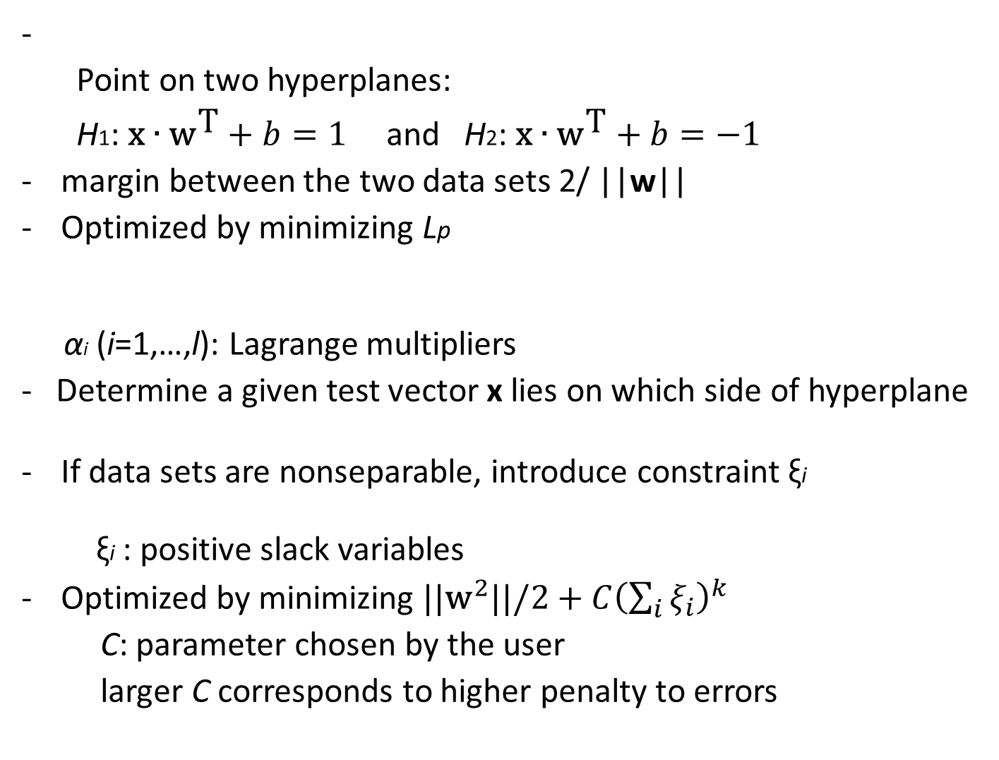
-
Point on two hyperplanes:
H1: $\text{x}∙{\text{w}}^{\text{T}}+b=1$ and H2: $\text{x}∙{\text{w}}^{\text{T}}+b=−1$
margin between the two data sets 2/ ||w||
Optimized by minimizing Lp
αi (i=1,…,l): Lagrange multipliers
- Determine a given test vector x lies on which side of hyperplane
If data sets are nonseparable, introduce constraint ξi
ξi : positive slack variables
Optimized by minimizing ${\text{||}\text{w}}^{2}||/2+C{\left(\sum_{i}{ξ_{i}}\right)}^{k}$
C: parameter chosen by the user
larger C corresponds to higher penalty to errors

Slide 12
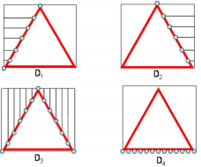
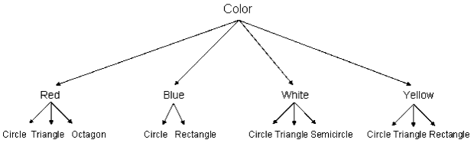
DtBs as feature vectors for the inputs of the linear SVMs
- DtBs: distances from the external edge of the blob to its bounding box
- segmentation colors → possible geometric shapes
- Octagonal is considered as circular and will be identified by the inner message
D1: left DtBs
D2: right DtBs
D3: upper DtBs
D4: bottom DtBs

Slide 13
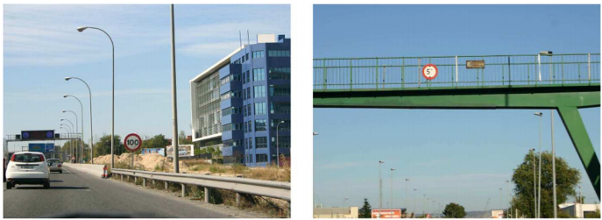


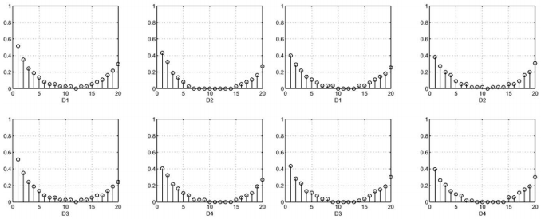
Four DtB vectors of 20 components feed specific SVMs
Original images
BoIs
DtB vectors

Slide 14
eg. Red blob
→ 4 DtB SVMs to classify circle (‘1’) or not (‘-1’)
→ 4 DtB SVMs to classify rectangle (‘1’) or not (‘-1’)
→ 4 favorable votes for each shape
Majority voting method with a threshold
# of votes < threshold → rejected as noisy shape
in case of a tie → linear SVM outputs of favorable classification
Invariant to translation, rotation and scale
- position of the candidate blob does not matter
- all blobs are oriented to a reference position
- DtB vectors are normalized to the bounding-box dimensions
- robust to occlusions

Slide 15
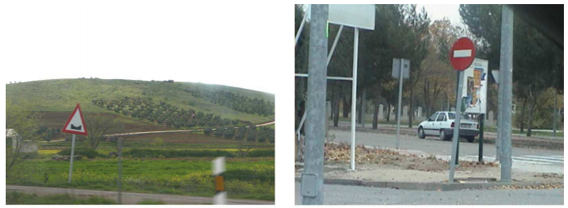

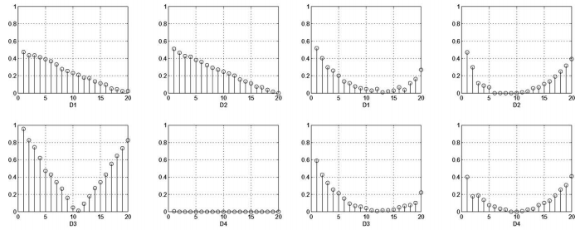
Rotation 3D invariance

Slide 16
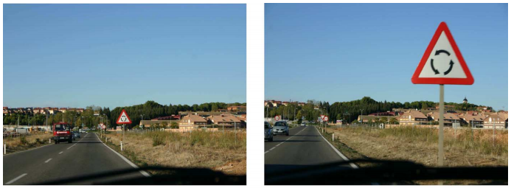

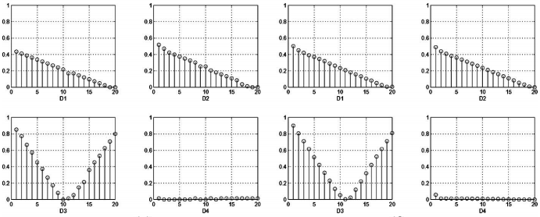
Scale invariance

Slide 17
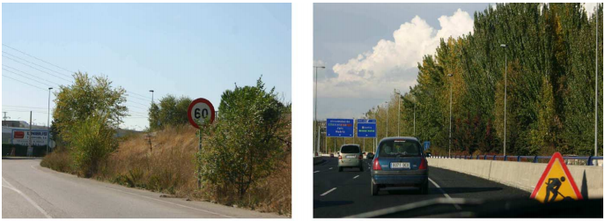

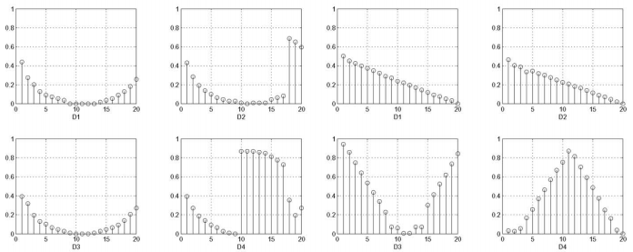
Occlusions

Slide 18



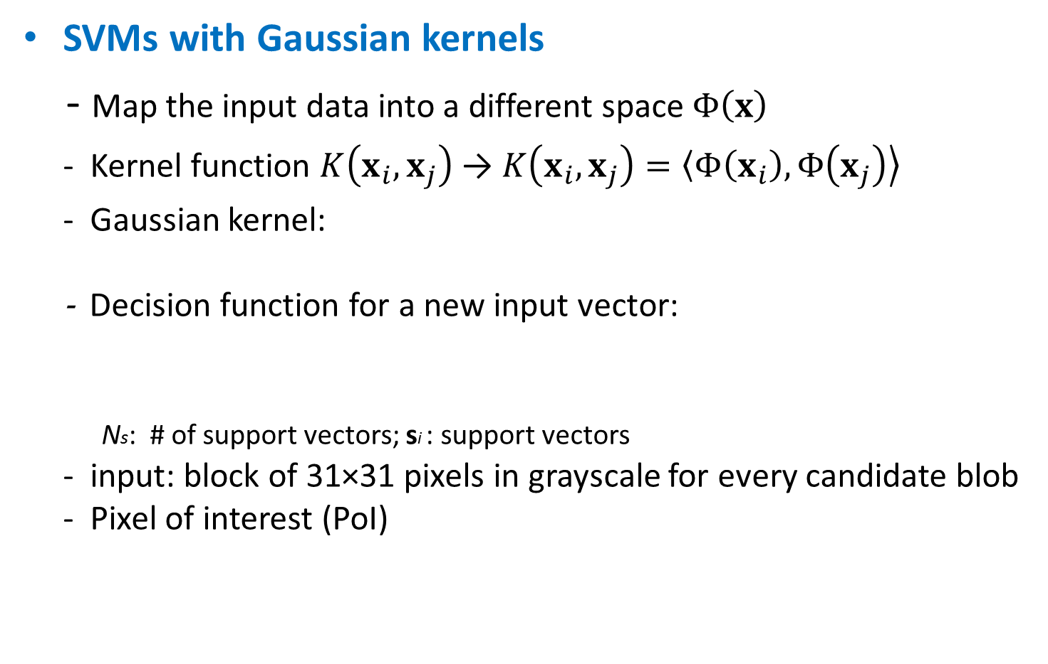
Recognition
SVMs with Gaussian kernels
- Map the input data into a different space $Φ\left(x\right)$
- Kernel function $K\left(x_{i},x_{j}\right)$ → $K\left(x_{i},x_{j}\right)=\left\langle Φ\left(x_{i}\right)\right.,\left.Φ\left(x_{j}\right)\right\rangle$
- Gaussian kernel:
- Decision function for a new input vector:
Ns: # of support vectors; si : support vectors
- input: block of 31×31 pixels in grayscale for every candidate blob
- Pixel of interest (PoI)

Slide 19

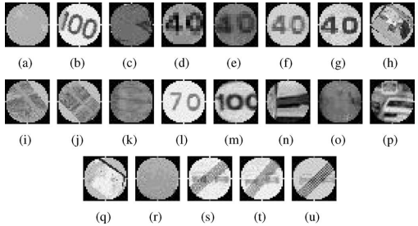
One-versus-all classification algorithm
- different one-versus-all SVMs classifiers → recognize every sign
- average of 50 training patterns for each class; some define the decision hyperplane as support vectors
Positive support vectors for “No overtake” traffic sign by achromatic segmentation
Negative support vectors

Slide 20
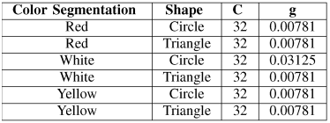
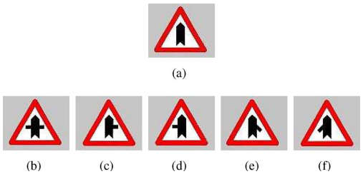
Optimum values for parameters in SVMs
lowest total number of errors in the training process
Test phase
Threshold values for discarding noise blobs are fixed at zero for decision functions of all SVMs. Value can be modified to change the false alarm probability and lost probability.
Exception
A set of triangular signs with high
level of similarity at low resolution
→ reorganize these signs within
a unique training set
C: cost parameter for the slack constraints
g: inverse of 2σ²

Slide 21
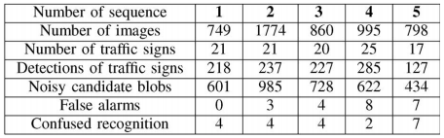
3. Results
Summary of results
all signs correctly detected in each of the 5 sequence at least twice
- confused recognition: long distances from the sign to camera or poor lighting
- traffic sign is identified at least in two frames of the sequence
→ correctly detected
- small blobs under 31×31 pixels are discarded to reduce the false alarm probability
Sequence 1, 2, 3: sunny lighting
Sequence 4: rainy day
Sequence 5: at night

Slide 22
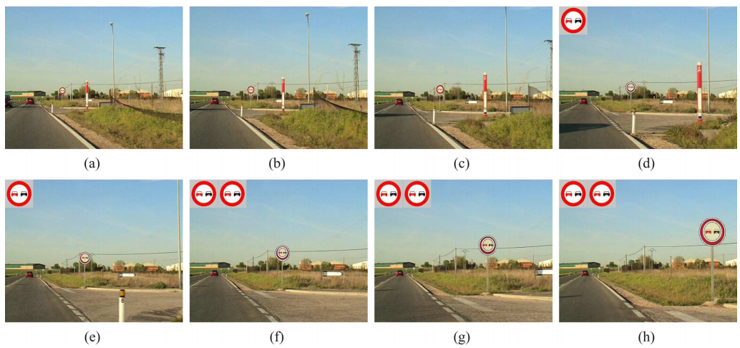
720 × 576 pixels, time step 0.2 s, 8 frames
External outline corresponds to segmentation by red color
Inside contour corresponds to the achromatic segmentation

Slide 23
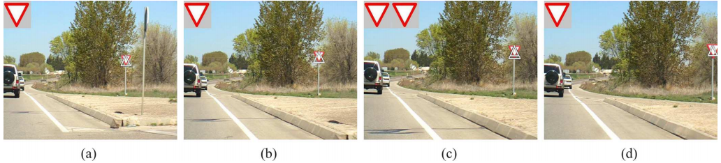
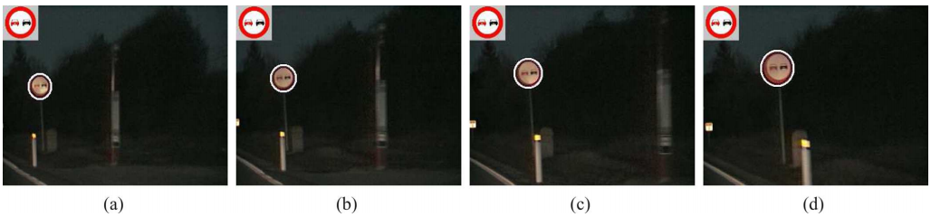
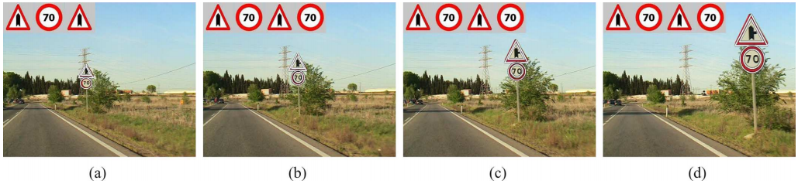
3-D rotation
At nignt
Arrays of two or more traffic signs

Slide 24
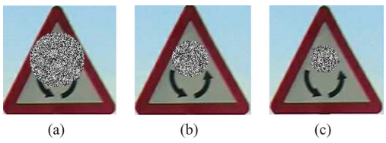
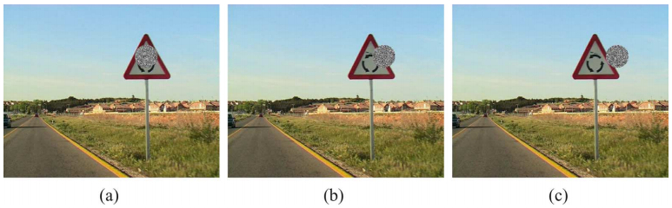
Different sizes of occlusions. ½, 1/3, ¼ of the major dimensions of the bounding box
Recognition success probabilities: 44.90%, 67.85%, 93.24%
Displacements of Masks of occlusion
Worst results: occlusion mask is place in the middle of the inner area

Slide 25
4. Conclusions
A complete system to detect and recognize traffic signs from a video sequence considering all existing difficulties
Linear SVMs for shape classification
Gaussian kernels for recognizing inner area
Candidate sign is valid if detected and recognized in at least two frames of a sequence
System is accurate to detect different geometric shapes
System works correctly in difficult situations
System is invariant to rotations, positions and scales
Able to detect signs occluded partially

