Slide 1
Eigenfaces for Recognition
Presented by: Santosh Bhusal

Slide 2
Introduction
Efficient, simple and accurate system for face recognition
Constrained environment: such as household, office etc.
2D model
Classification performed using linear combination of characteristic features: eigenfaces

Slide 3
Motivation
Previous work on face recognition ignores the question of which features are important for classification and which are not.

Slide 4
Basic Approach
Initialization
Acquire training images
Calculate eigenfaces from the training set
the known individuals are projected into the face space, and their weights are stored.
Recognition
Projecting the input image to face space to calculate the weight based on the eigenfaces
Determine if the image is face or not
If face determine if it is known or unknown
Face space can be updated for new face images (optional)

Slide 5
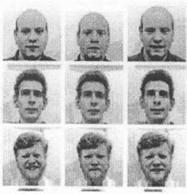
Acquiring Training Images
Collect n samples for each p persons (I_{11,} I_{12,} …. I_{1n,} I_{21,} I_{22,}….I_{2n,}… I_{p1,} …. I_{pn})
Each of size MXN. (same size for all)
Each face must be centered.
p samples for size, intensity, shape variation etc.
Calculating Face space
Compute the average face vector.
ψ =1/np*Σ I_{xy}
where x=1 to p, y=1 to n
subtract the mean face
Φ_{i} = I_{xy} – ψ
Represent every face image Φ_{i} by a vector г_{i} of size (MNX1) such that
г_{i} =[Φ_{i} (1,1), Φ_{i} (1,2),.. ……………Φ_{i} (M,N)]^{T}
Form a matrix a such that
A=[г₁ г₂ г₃ ... г_{pn}]
Form the covariance matrix C such that
C=AA^{T}

Slide 6
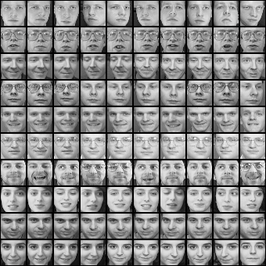
Training Images and mean Image
Mean Image
Training Image

Slide 7
Face space contd….
Compute the eigenvectors u_{i} of matrix C.
Cu_{i}=λ_{i}u_{i}
The matrix C is very large → not Practical!
Consider the matrix A^{T}A (npXnp matrix)
Compute the eigenvectors v_{i} of matrix A^{T}A
A^{T}A v_{i} =µ_{i} v_{i}
Relation between u_{i} and v_{i}
A^{T}A v_{i} =µ_{i} v_{i}
AA^{T}A v_{i} =µ_{i} A v_{i}
C(A v_{i})= µ_{i} (A v_{i})
Hence: u_{i}=Av_{i} and λ_{i} =µ_{i}
Here, the np eigenvalues and eigenvector of small matrix corresponds to the np largest eigenvalues and eigenvectors of the large matrix C
Keep only K eigenvectors corresponding to K largest eigenvalues. (Principal Component)

Slide 8
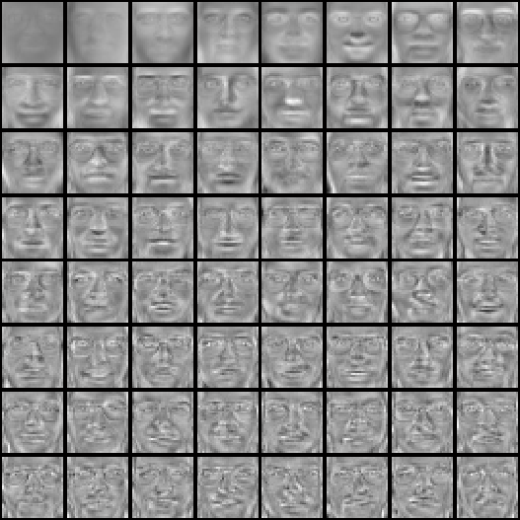
Eigenfaces Example
Top K eigenvectors

Slide 9
Calculating Weight Coefficient
Each face image : linear combination of eigenvectors.
Φ_{i} = $\sum_{i=1}^{k}{w_{i}u_{i}}$
Eigenvectors for symmetric matrix are orthogonal
${u_{i}}^{T}$.$u_{j}=$
So, ${{\text{Φ}}_{x}}^{T}. u_{i}=$($\sum_{i=1}^{k}{w_{i}u_{i}).}u_{i}$
${{\text{Φ}}_{x}}^{T}. u_{i}=w_{i}$
Thus, weights are calculated as $w_{i}$=${{\text{Φ}}_{x}}^{T}. u_{i}$

Slide 10
Recogition of face Image
A new face image г is transferred into its eigenface components
ω_{K} = u_{K}^{T} (г-ψ)
the weight form a vector
Ω^{T} = [ω₁, ω₂,...ω_{K} ]
Find the face class j that minimizes the Euclidian distance
є_{j}² =||Ω- Ω_{j}||²
where, Ω_{j} is a vector describing j^{th} class
If є_{j} < Ө_{e}, the face belongs to class j.

Slide 11
Contd…

Slide 12
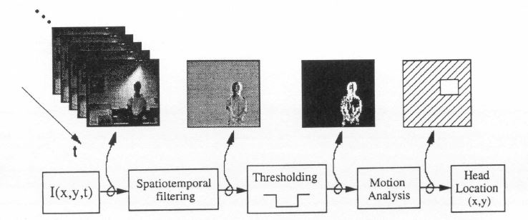
Location and Detection
Frame differencing to track motion against static background
Filtering the threshold image to produce motion blobs
Small upper blob above the large blob(body) moving slowly is a head
Scale the size of blob to estimate the face or fit in the face space

Slide 13
Other Issues
Background changes cause problem:
De-emphasize the outside of the face (e.g., by multiplying the input image by a 2D Gaussian window centered on the face).
Performance decreases quickly to face size:
Multi-scale eigenfaces
Scale input image to multiple size
Performance decreases with changes to face orientation: (but not as fast as with scale changes)
Plane rotations are easier to handle.
Out-of-plane rotations are more difficult to handle.

Slide 14
Experiments
Various lightening, scale and orientation
More than 2500 face images of the 16 subjects using combination of 3 head orientation, 3 head size and 3 lightening condition
A six level Gaussian pyramid was constructed resulting in resolutions from 512 x 512 to 16 x 16.
Training
first experiment: infinite threshold, 1 image per class at a ﬁxed orientation, size and lighting
Result:96% recognition over varied lighting, 85% over varied orientation and 64% over varied size
Second experiment: varied Θ_{e}
Low Θ_{e} : high recognition but many unknown image
High Θ_{e}: low unknowns but high error.
Adjusting threshold for 100% recognition, resulted 19% unknown for lighting, 39% unknown for orientation and 60% for size.

Slide 15
Questions???

