Slide 1

Segmentation as Selective Search for Object Recognition
Kaushik Nandan

Slide 2
Contents:
Introduction
Related Work
Segmentation as Selective Search
Object Recognition System
Evaluation
Conclusions
References

Slide 3
1. Introduction
Object recognition: determining position & class of an object.
State-of-the-art is based on exhaustive search over the image to find the best object positions.
Total number of images and windows to evaluate in an exhaustive search is huge and growing.
Necessary to constrain computation per location & no of locations considered.
Currently, computation is reduced by using a weak classifier with simple-to-compute features & by reducing the no of locations on a coarse grid and with fixed window sizes.
This comes at the expense of overlooking some object locations and misclassifying others.

Slide 4
1. Introduction
Selective search, greatly reduces no of locations.
SOA methods focus on finding accurate object contours, hence, references use a powerful, specialized contour detector creating a pixel-wise classification of the image.
Both concentrate on 10-100 possibly overlapping segments per image, which best correspond to an object.
For boosting object recognition:
We, generate several thousand locations per image guarantees the inclusion of virtually all objects, and
rough segmentation includes the local context known to be beneficial for object classification.
These parts of the image bear the most information for object classification.

Slide 5
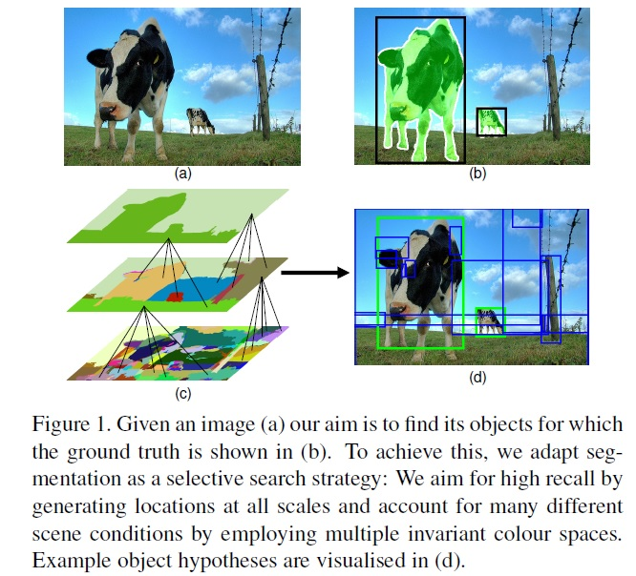
Introduction

Slide 6
Introduction
In this method:
We reconsider segmentation by adapting it as an instrument to select the best locations for object recognition. Most emphasis on recall and prefer good object approximations over exact object boundaries.
Accounting for scene conditions through invariant color spaces results in a powerful selective search strategy with high recall.
Selective search enables use of more expensive features such as bag-of-words & substantially improves the state-of-the-art on the Pascal VOC 2010 detection challenge for 8 out of 20 classes.

Slide 7
2. Related Work
Exhaustive Search for Recognition:
Emphasis on recognition. Determining the object class is more important than finding the exact contours and an exhaustive search is the norm.
Selective Search for Object Delineation
Work with emphasis on object delineation. Here object contours are most important and the use of segmentation is the norm.
As an object can be located at any position and scale in the image, it is natural to search everywhere.
Visual search space is huge, making an exhaustive search computationally expensive.
This imposes constraints on the evaluation cost per location and/or the number of locations considered. Hence most of these sliding window techniques use a coarse search grid and fixed aspect ratios, using weak classifiers and economic image features such as HOG

Slide 8
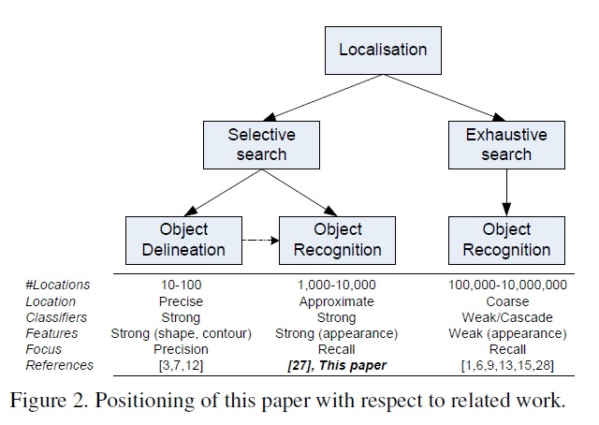
Related Work

Slide 9
3. Segmentation as Selective Search
High recall: To obtain this we observe the following:
Objects can occur at any scale within an image. some objects are contained within other objects. Hence it is necessary to generate locations at all scales.
There is no single best strategy to group regions together: An edge may represent an object boundary in one image. Hence rather than aiming for the single best segmentation, it is important to combine multiple complementary segmentations.
Coarse locations are sufficient
Fast to compute

Slide 10
Segmentation Algorithm: As regions can yield richer information than pixels, we start with an over segmentation. We use the fast method of as our starting point, which is well suited for generating an over segmentation.
greedy algorithm:
iteratively groups two most similar regions together and calculates the similarities between this new region and its neighbours. We continue until the whole image becomes a single region.
Similarity S between region a and b as
S(a; b) = Ssize (a, b) + Stexture (a, b). [0,1]
Ssize(a;b) is defined as the fraction of the image that the segment a and b jointly occupy.

Slide 11
Stexture (a, b) is defined as the histogram intersection between SIFT-like texture measurements.
aggregate the gradient magnitude in 8 directions over a region, just like in a single subregion of SIFT with no Gaussian weighting

Slide 12
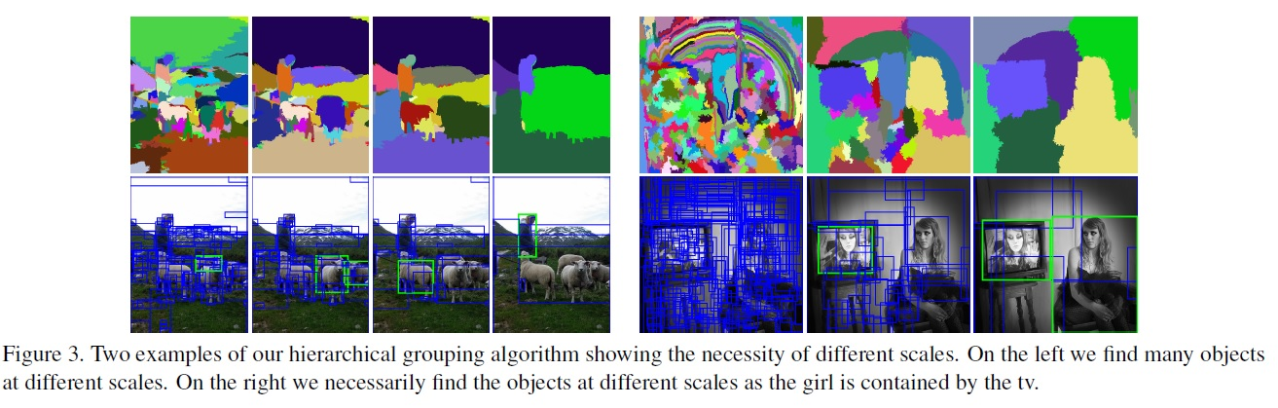
Segmentation as Selective Search

Slide 13
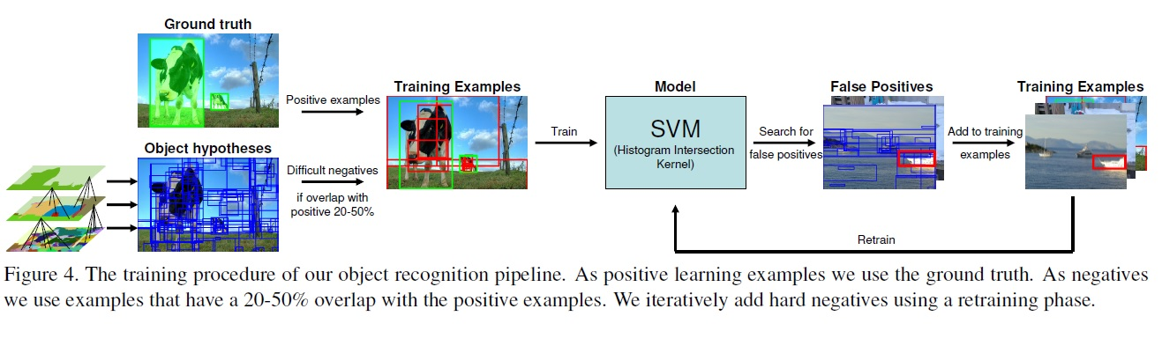
Segmentation as Selective Search

Slide 14
4. Object Recognition System
As feature representation, two types of features are dominant: histograms of oriented gradients (HOG) and bag-of-words.
HOG is better suited for rigid objects and our features are better suited for deformable object types.
5. Evaluation:
Experiment 1: Segmentation for Selective Search:
Evaluates how to adapt segmentation for selective search. Specifically we compare multiple flat segmentations against a hierarchy and evaluate the use of increasingly invariant color spaces.

Slide 15
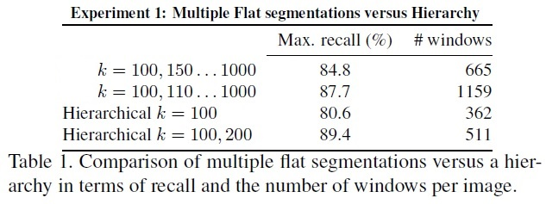
Flat versus Hierarchy:

Slide 16
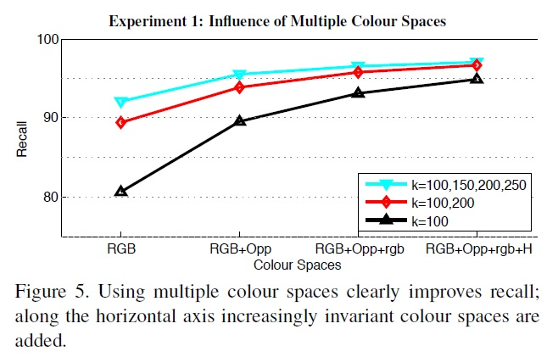
Evaluation
Multiple Color Spaces:

Slide 17
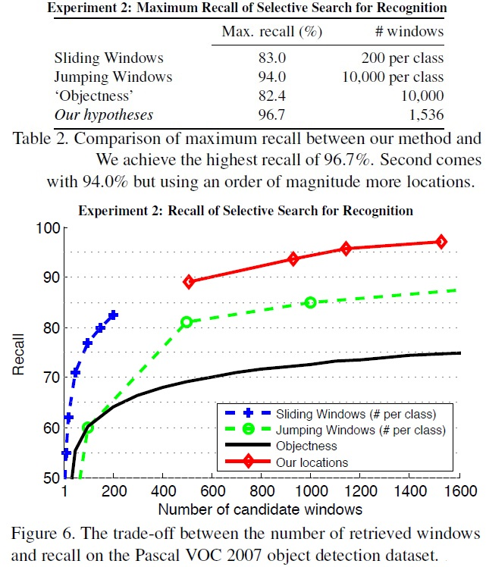
Evaluation
Experiment 2: Selective Search for Recognition

Slide 18
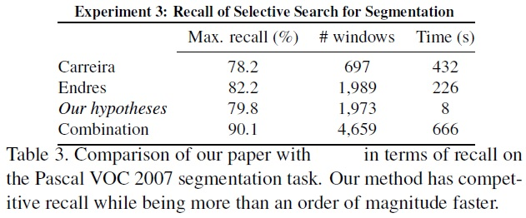
Evaluation
Experiment 3 : Selective Search for Object Delineation

Slide 19
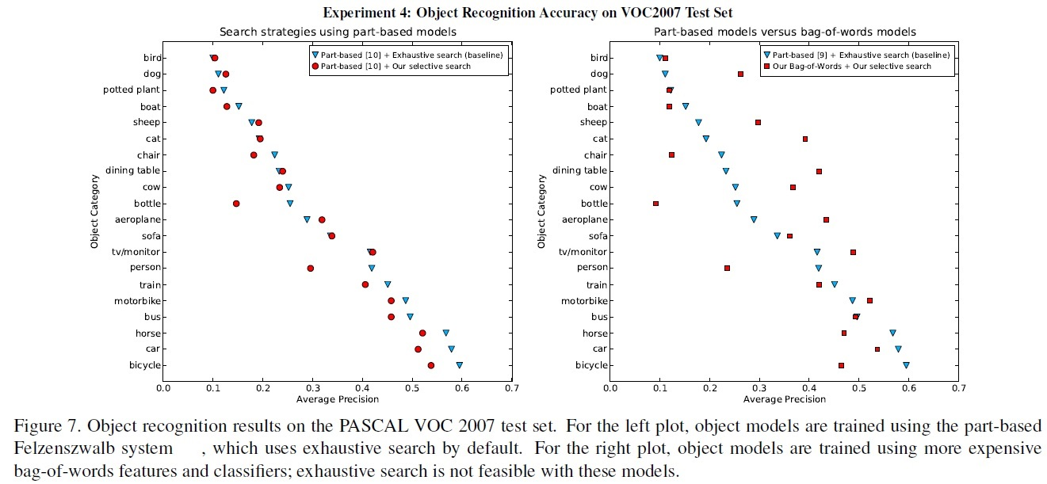
Experiment 4: Object Recognition Accuracy
Search strategies using part-based models
Part-based HOG versus bag-of-words

Slide 20
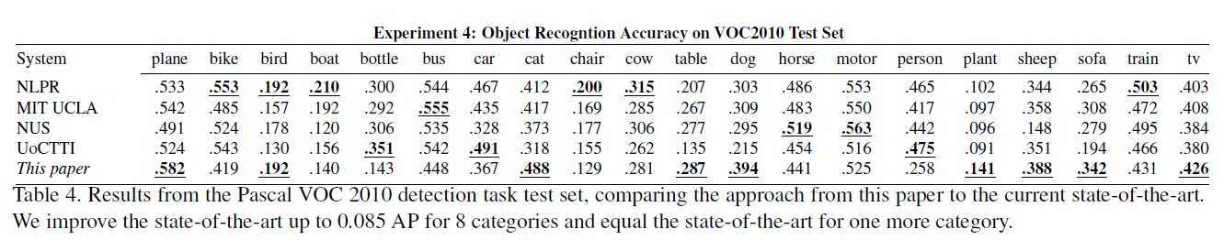
Comparison to the state-of-the-art

Slide 21
Conclusions
Segmentation as a selective search strategy for object recognition.
Generates many approximate locations over few and precise object delineations.
Objects whose locations are not generated can never be recognized.
Selective search uses locations at all scales.
Instead of using a single best segmentation algorithm, it is prudent to use a set of complementary segmentations.
Paper accounts for different scene conditions such as shadows, shading, and highlights by employing a variety of invariant color spaces.

Slide 22
Conclusions
This generates only 1,536 class independent locations /image to capture 96.7% of all the objects in the Pascal VOC 2007 test set. This is the highest recall reported to date.
Segmentation as a selective search strategy is highly effective for object recognition.
In part-based system the no of considered windows can be reduced by 20 times at a loss of 3% Mean Average Precision overall.
Since, number of locations reduced we can do object recognition using a powerful yet expensive bag-of-words implementation and improve the state-of-the-art for 8 out of 20 classes for up to 8.5% in terms of Average Precision.

Slide 23
References
[1] B. Alexe, T. Deselaers, and V. Ferrari. What is an object? In
CVPR, 2010.
[2] P. Arbel´aez, M. Maire, C. Fowlkes, and J. Malik. Contour detection and hierarchical image segmentation. TPAMI, 2011.
[3] J. Carreira and C. Sminchisescu. Constrained parametric min-cuts for automatic object segmentation. In CVPR, 2010.
[4] O. Chum and A. Zisserman. An exemplar model for learning object classes. In CVPR, 2007.
[5] G. Csurka, C. R. Dance, L. Fan, J. Willamowski, and C. Bray. Visual categorization with bags of key points. In ECCV Statistical Learning in Computer Vision, 2004.
[6] N. Dalal and B. Triggs. Histograms of oriented gradients for human detection. In CVPR, 2005.
[7] I. Endres and D. Hoiem. Category independent object proposals. In ECCV, 2010.

Slide 24

Questions?

Slide 25
PASCAL Visual Object Classes (VOC) Challenge
A benchmark in visual object category recognition and detection, providing the vision and machine learning communities with a standard dataset of images and annotation, and standard evaluation procedures.
There are two principal challenges:classification—“does the image contain any instances of a particular object class?” (where the object classes include cars, people, dogs, etc.), and detection— “where are the instances of a particular object class in the image (if any)?”
In addition, there are two subsidiary challenges (“tasters”) on pixel-level segmentation—assign each pixel a class label, and “person layout”—localise the head, hands and feet of people in the image.

Slide 26
Bag-of-words model
A text (sentence/ document) is represented as the bag (multiset) of its words, disregarding grammar and even word order but keeping multiplicity, used in methods of document classification, frequency of occurrence of each word is used as a feature for training a classifier. e.g.
(1) John likes to watch movies. Mary likes movies too.
(2) John also likes to watch football games.
[ "John", "likes", "to", "watch", "movies", "also", "football", "games", "Mary", "too" ] which has 10 distinct words.
And using the indexes of the list, each document is represented by a 10-entry vector:
(1) [1, 2, 1, 1, 2, 0, 0, 0, 1, 1]
(2) [1, 1, 1, 1, 0, 1, 1, 1, 0, 0]

Slide 27
20 classes
aeroplane, airplane, plane, biplane, monoplane, aviator, bomber, hydroplane, airliner, aircraft, fighter, airport, hangar, jet, boeing, fuselage, wing, propellor, flying
– bicycle, bike, cycle, cyclist, pedal, tandem, saddle, wheel, cycling, ride, wheelie
– bird, birdie, birdwatching, nest, sea, aviary, birdcage, bird feeder, bird table
– boat ship, barge, ferry, canoe, boating, craft, liner, cruise, sailing, rowing, watercraft, regatta, racing, marina, beach, water, canal, river, stream, lake, yacht
– bottle, cork, wine, beer, champagne, ketchup, squash, soda, coke, lemonade, dinner, lunch, breakfast
– bus, omnibus, coach, shuttle, jitney, double-decker, motorbus, school bus, depot, terminal, station, terminus, passenger, route
– car, automobile, cruiser, motorcar, vehicle, hatchback, saloon, convertible, limousine, motor, race, traffic, trip, rally, city, street, road, lane, village, town, centre, shopping, downtown, suburban
– cat, feline, pussy, mew, kitten, tabby, tortoiseshell, ginger, stray
– chair, seat, rocker, rocking, deck, swivel, camp, chaise, office, studio, armchair, recliner, sitting, lounge, living room, sitting room
– cow, beef, heifer, moo, dairy, milk, milking, farm
– dog, hound, bark, kennel, heel, bitch, canine, puppy, hunter, collar, leash
– horse, gallop, jump, buck, equine, foal, cavalry, saddle, canter, buggy, mare, neigh, dressage, trial, racehorse, steeplechase, thoroughbred, cart, equestrian, paddock, stable, farrier
– motorbike, motorcycle, minibike, moped, dirt, pillion, biker, trials, motorcycling, motorcyclist, engine, motocross, scramble, sidecar, scooter, trail
– person, people, family, father, mother, brother, sister, aunt, uncle, grandmother, grandma, grandfather, grandpa, grandson, granddaughter, niece, nephew, cousin
– sheep, ram, fold, fleece, shear, baa, bleat, lamb, ewe, wool, flock
– sofa, chesterfield, settee, divan, couch, bolster
– table, dining, cafe, restaurant, kitchen, banquet, party, meal
– potted plant, pot plant, plant, patio, windowsill, window sill, yard, greenhouse, glass house, basket, cutting, pot, cooking, grow
– train, express, locomotive, freight, commuter, platform, subway, underground, steam, railway, railroad, rail, tube, underground, track, carriage, coach, metro, sleeper, railcar, buffet, cabin, level crossing
– tv/monitor, television, plasma, flatscreen, flat screen, lcd, crt, watching, dvd, desktop, computer, computer monitor, PC, console, game.

Slide 28
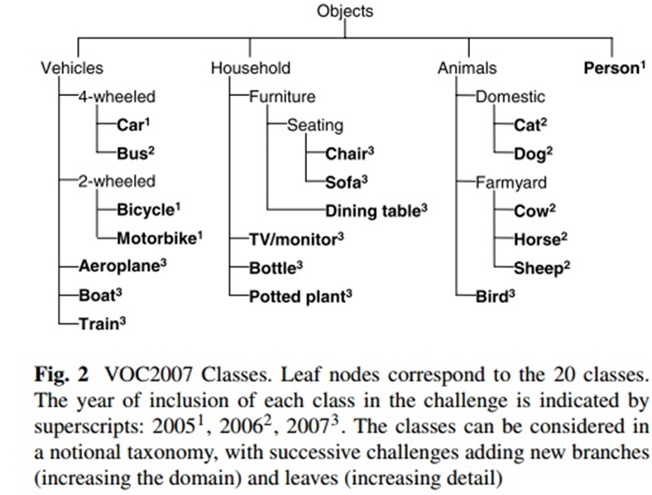
choice of object classes:
(i) exploiting visual properties common to classes e.g. vehicle wheels, for example in the form of “feature sharing” (ii) exploiting external semantic information about the relations between object classes for example by learning a hierarchy of classifiers. The availability of a class hierarchy may also prove essential in future evaluation efforts if the number of classes increases to the extent that there is implicit ambiguity in the classes, allowing individual objects to be annotated at different levels of the hierarchy e.g. hatchback/car/vehicle.

Slide 29
Annotated Attributes:
– class: one of: aeroplane, bird, bicycle, boat, bottle, bus, car, cat, chair, cow, dining table, dog, horse, motorbike, person, potted plant, sheep, sofa, train, tv/monitor.
– bounding box: an axis-aligned bounding box surrounding the extent of the object visible in the image.
viewpoint: one of: front, rear, left, right, unspecified. This annotation supports methods which treat different viewpoints differently during training, such as using separate detectors for each viewpoint.
– truncation: an object is said to be “truncated” when the bounding box in the image does not correspond to the full extent of the object. This may occur for two reasons: (a) the object extends outside the image e.g. an image of a person from the waist up; (b) the boundary of the object is occluded e.g. a person standing behind a wall. The aim of including this annotation was to support recognition methods which require images of an entire object as training data, for example assuming that the bounding boxes of the objects can be aligned.

