Slide 1
Low Power Design of VLSI Circuits
Bill Jason P. Tomas
ECG 720 Electronic Design with ICs
Department of Electrical and Computer Engineering
University of Nevada- Las Vegas

Slide 2
Motivation
Technology is shrinking (22 nm technology introduced by semiconductor companies in 2011)
→ more transistors are able to fit on a chip (also increasing)
Clock frequency is increasing
Power supply voltage is decreasing
But…Power Dissipation is INCREASING!

Slide 3
Motivation
Year | 1999 | 2002 | 2005 | 2008 | 2011 | 2014
Feature size (nm) | 180 | 130 | 100 | 70 | 50 | 35
Logic transistors/cm² | 6.2M | 18M | 39M | 84M | 180M | 390M
Clock (GHz) | 1.25 | 2.1 | 3.5 | 6.0 | 10.0 | 16.9
Chip size (mm²) | 340 | 430 | 520 | 620 | 750 | 900
Power supply (V) | 1.8 | 1.5 | 1.2 | 0.9 | 0.6 | 0.5
High-perf. Power (W) | 90 | 130 | 160 | 170 | 175 | 183
Source: http://www.semichips.org

Slide 4
VLSI Chip Power Densities
10000
Surface of the sun
1000
Nuclear Reactor
100
Power Density (W/cm²)
Average Stove
8086
10
4004
P6
8008
8085
386
Pentium®
8080
286
486
1
1970
1980
1990
2000
2010
Year
Source: Intel

Slide 5
Gate Level Examples of Low Power (Binary Counter)
a
b
Present state |  | Next state
a | b | A | B
0 | 0 | 0 | 1
0 | 1 | 1 | 0
1 | 0 | 1 | 1
1 | 1 | 0 | 0
A
B
clk
clr
A = a’b + ab’
B = a’b’ + ab’

Slide 6
Binary Counter- Grey Coding
a
b
Present state |  | Next state
a | b | A | B
0 | 0 | 0 | 1
0 | 1 | 1 | 1
1 | 0 | 0 | 0
1 | 1 | 1 | 0
A
B
clk
clr
A = a’b + ab
B = a’b’ + a’b

Slide 7
Binary Counter State Encoding
Two-bit binary counter:
    State sequence, 00 → 01 → 10 → 11 → 00
    Six bit transitions in four clock cycles
    6/4 = 1.5 transitions per clock
Two-bit Gray-code counter
    State sequence, 00 → 01 → 11 → 10 → 00
    Four bit transitions in four clock cycles
    4/4 = 1.0 transition per clock
Gray-code counter is more power efficient.

Slide 8
Power and Energy
Power is drawn from a voltage source attached to the V_{DD} pin(s) of a chip.
Instantaneous Power:
Energy:
Average Power:

Slide 9
Power Dissipation Components in CMOS Circuits
Dynamic
  Signal transitions (charging and discharging of load capacitance)
    Logic activity
    Glitches
  Short-circuit (direct current from Vdd to GND when both PMOS and NMOS networks are on)
Static
  Leakage: when input is not switching.
P_{total} = P_{dyn} + P_{stat}
= P_{tran} + P_{sc} + P_{stat}

Slide 10
Static Power
Static Power Consumption
  Static current does exist in CMOS as long at input voltage is less than the threshold of the NMOS transistor (V_{in} < V_{TN} ) or greater than the threshold voltage of the PMOS added to the power supply voltage (V_{in} > V_{DD}+V_{TP})
  Leakage current is determined by the transistor which is cut-off
  Determined by the W/L values of the transistor, supply voltage, and threshold voltages
V_{DD}
V_{DD}
I_{leak,p}
V_{I}<V_{TN}
Vcc
V_{DD}
Vo(low)
I_{leak,n}

Slide 11
Static Power
Drain junction leakage
Small reverse leakage current is formed due to the formation of reverse bias between diffusion regions and wells , and wells and substrates.
Gate leakage
SiO2 is a very good insulator, but at small thickness, electrons can tunnel across very thin insulation
Vout
Sub-threshold current
Current between source and drain in weak inversion region ( Vgs < Vth)
I_{DS} = μ₀ C_{ox} (W/L) V_{t}² exp{(V_{GS} –V_{TH} ) / nV_{t} }
Short-Channel Devices
(channel length comparable to depth of drain and source junctions and depletion width
I_{DS}= μ₀ C_{ox}(W/L)V_{t}² exp{(V_{GS} –V_{TH} + ηV_{DS})/nV_{t}}
μ₀: carrier surface mobility
C_{ox}: gate oxide capacitance per unit area
L: channel length
W: gate width
V_{t} = kT/q: thermal voltage
n: a technology parameter
V_{DS} = drain to source voltage
η: a proportionality factor

Slide 12
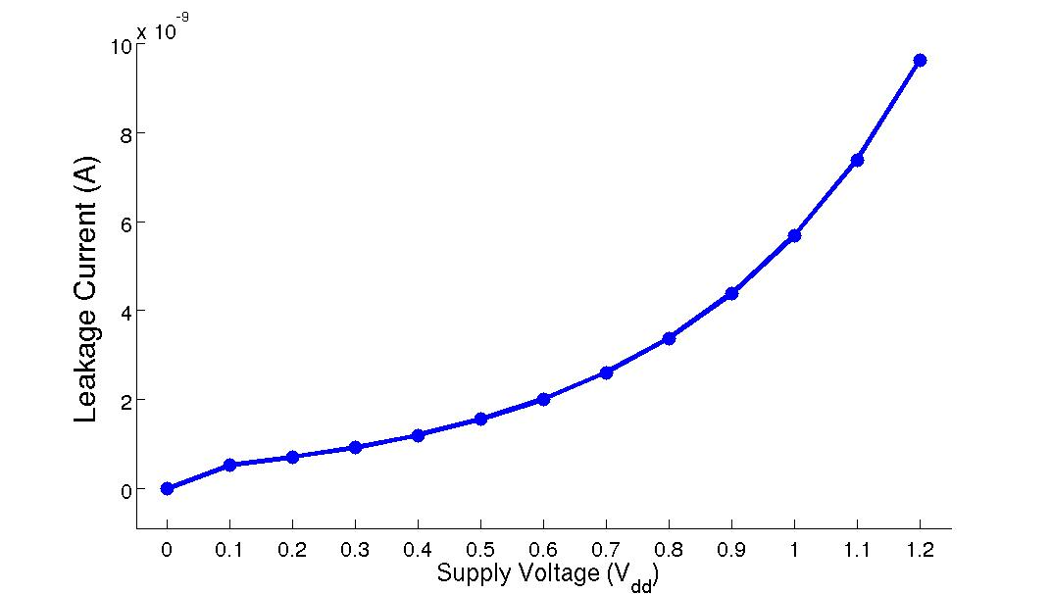
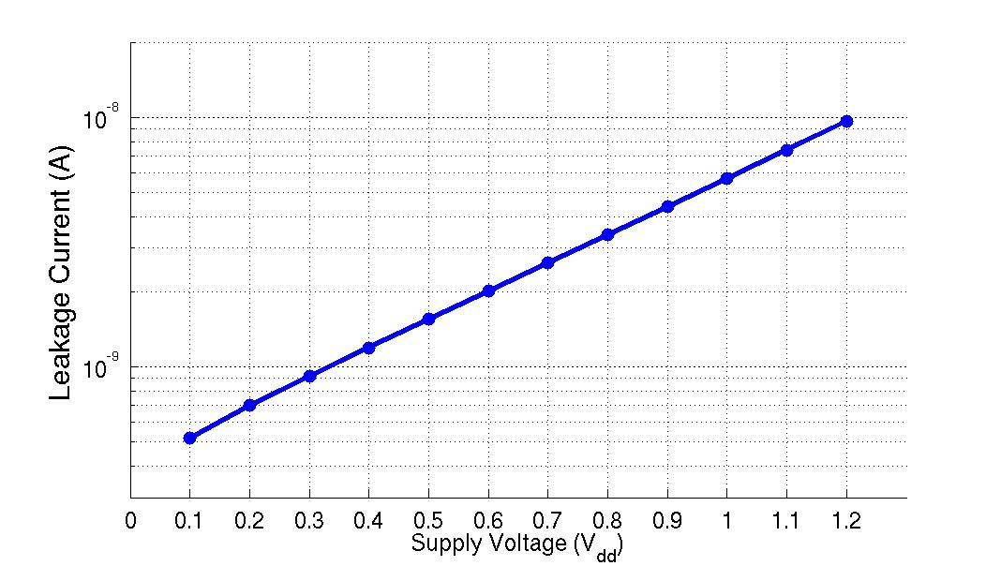
Subthreshold Current I_{sub}
90nm CMOS inverter (Auburn University)
    L = 90nm, W_{p} = 495nm, W_{n} = 216nm
    Temperature 300K (room temperature)
    Input set to 0 volt
    V_{thn} = 0.291V, V_{thp} =0.209V at V_{DD} = 1.2V (nominal)

Slide 13
Scaled Device Subthreshold Leakage
Scaled device
I_{c}
Log (Drain current)
I_{sub}
0
V_{TH}’
V_{TH}
Gate voltage
Leakage power as a fraction of the total power increases as the clock frequency drops. For a gate, it is a small fraction of total power, but can be very significant for a large circuit. Scaling down requires lower the threshold voltage, which increases leakage voltage.

Slide 14
Dynamic Switching Power
Case I: When the input is at logic 0: Under this condition the PMOS is conducting and NMOS is in cutoff mode and the load capacitor must be charged through the PMOS device.
Power dissipation in the PMOS transistor is given by,
P_{P}=i_{L}V_{SD}= i_{L}(V_{DD}-V_{O})
The current and output voltages are related by,
i_{L}=C_{L}dv_{O}/dt
Similarly the energy dissipation in the PMOS device can be written as the output switches from low to high ,
.

Slide 15
Dynamic Switching Power
Case II: when the input is high and out put is low:
During switching all the energy stored in the load capacitor is dissipated in the NMOS device because NMOS is conducting and PMOS is in cutoff mode. The energy dissipated in the NMOS inverter can be written as,
The total energy dissipated during one switching cycle is,
The power dissipated in terms of frequency can be written as
Because most gates do not switch every clock cycle, it is often more convenient to write the frequency as an activity factor times the clock frequency thus: P= αfC_LVdd^2

Slide 16
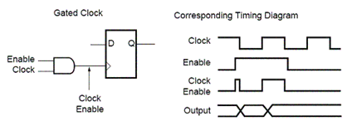
Glitch Activity
A glitch is a undesired transition that occurs before the signal settles to its intended value. It is a electrical pulse for a short duration that is usually the result of a fault or design error.

Slide 17
Short Circuit Power
V_{DD}
V_{DD}
I_{max}
i_{sc}(t)
v_{i} (t)
v_{o}(t)
I_{D}
V_{o}
C_{L}
Ground
V_{i}
V_{DD}
Short circuit current flows during the brief transient when the pull down and pull up devices both conduct at the same time where one (or both) of the devices are in saturation

Slide 18
Short Circuit Power
I_{sc} ≈ 0
I_{sc} ≈ I_{max}
Vin
Vout
Vin
Vout
C_{L}
C_{L}
Large capacitive load
Output fall time > Input rise time
Small capacitive load
Output fall time < Input rise time
Increases with rise and fall times of input.
Decreases for larger output load capacitance; large capacitor takes most of the current.
Small, about 5-10% of dynamic power; momentary shorting of supply and ground during opening and closing of transistor switches.

Slide 19
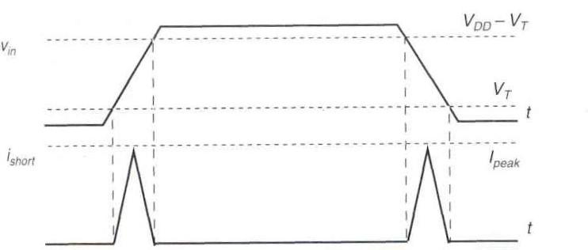
Dynamic Short Circuit Power
I_{max}

Slide 20
Power Dissipation in CMOS Circuits
Total power consumption
Dynamic power
(≈ 40 - 70% today and decreasing relatively)
Short-circuit power
(≈ 10 % today and decreasing absolutely)
Leakage power
(≈ 20 – 50 % today and increasing)

Slide 21
Levels of Power Reduction
HW/SW co-design, Custom ISA,
Algorithm design
System
Architectural
Scheduling, Pipelining, Binding
RTL - Level
Clock gating, State assignment, Retiming
Logic
Logic restructuring, Technology mapping
Fan-out Optimization, Buffering, Transistor
sizing, Glitch elimination
Physical

Slide 22
Reducing Power
Reducing dynamic capacitive power:
  Lower the voltage
    Quadratic effect on dynamic power
  Reduce capacitance
    Short interconnect lengths
    Drive small gate load (small gates, small fan-out)
  Reduce frequency
    Lower clock frequency
    Lower signal activity (alpha)
Reducing short-circuit current:
  Fast rise/fall times on input signal
  Reduce input capacitance
  Insert small buffers to “clean up” slow input signals before sending to large gate
Reducing leakage current:
  Small transistors (leakage proportional to width)
  Lower voltage

Slide 23
Reducing the α(activity factor)
If a circuit can be turning off entirely, the activity factor and the dynamic power → 0
Blocks are typically turned off by stopping the clock which is called clock gating
When a component is on, the activity factor is 1 for clocks and substantially lower for nodes in logic circuits (some
  If the signal switches once per cycle, α=1/2
  Dynamic gates switch either zero or twice per cycle: α=1/2
  Static gates switch depending on their design, but typically α=0.1

Slide 24
Clock Gating
PI
Combinational
logic
PO
Flip-flops
Clock
activation
logic
Latch
L. Benini and G. De Micheli,
Dynamic Power Management,
Boston: Springer, 1998.
CK

Slide 25
Clock Gating
Clock gating ANDs a clock signal with an enable to turn off the clock to idle blocks. This is highly effective since the clock has a high activity factor, and by gating the clock to input register, it prevents them from switching and thus stops all activity in the fan-out combination logic.
While the clock is active (1 or 0 for rising or falling edge), the clock enable must be stable. The enable latch is used to gurantee that the enable does not change before the clock falls (or rises)
When a large block of logic is turned off, the clock can be gated early in the clock tree, turning off a portion of the global network. The clock network has an activity factor of 1 and a high capacitance, so this save significant power.

Slide 26
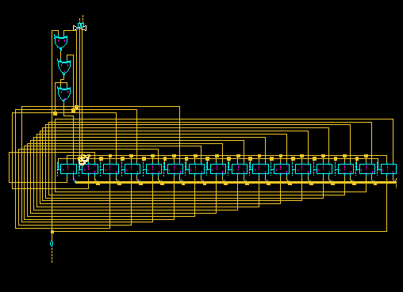
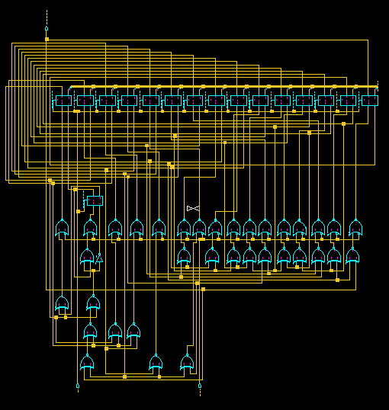
16-bit LFSR vs 16-bit gated LFSR
Un-gated
 | Without clock gating | With clock gating
Max power | 37.939 mW | 30.144 mW
Min power | 45.6137 nW | 62.4403 nW
Avg power | 5.6966 mW | 4.913 mW
Gated
Initialization of LFSR Values

Slide 27
Logic Restructuring
Logic restructuring: changing the topology of a logic network to reduce transitions
AND: P_{0→1} = P₀ * P₁ = (1 - P_{A}P_{B}) * P_{A}P_{B}
3/16
0.5
(1-0.25)*0.25 = 3/16
A
Y
A
W
B
7/64 = 0.109
0.5
B
X
F
15/256
0.5
C
C
0.5
D
F
D
Z
0.5
0.5
3/16 = 0.188
Chain implementation has a lower overall switching activity than tree implementation for random inputs
BUT: Ignores glitching effects

Slide 28
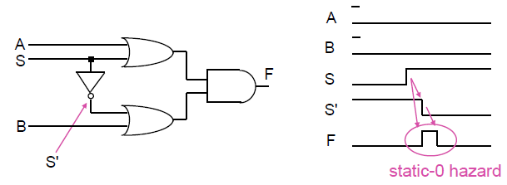
Glitches
Switching probabilities are only valid if each gate has zero propagation delay, but this is not true in real life.
Widths of hazards is usually equal to delay difference between paths
Glitch Solutions:
Add redundant terms in your K-map
Use synchronous inputs (since glitches wont be processed because data waits for a clock edge)
Never use asynchronous inputs

Slide 29
Coping with Glitching?
0
F
1
0
1
1
F
1
0
F
0
2
2
F
F
3
0
3
0
F
0
2
1
0
Equalize Lengths of Timing Paths Through Design

Slide 30
Input Ordering
(1-0.5x0.2)*(0.5x0.2)=0.09
(1-0.2x0.1)*(0.2x0.1)=0.0196
0.5
0.2
A
B
X
X
B
C
F
0.1
A
F
0.2
C
0.1
0.5
AND: P_{0→1} = (1 - P_{A}P_{B}) * P_{A}P_{B}
Beneficial: postponing introduction of signals with a high transition rate (signals with signal probability close to 0.5)

Slide 31
Datapath Modification to Lower Power
Combinational
logic
Input
Register
Register
Output
C_{ref}
CLK
Supply voltage = V_{ref}
Total capacitance switched per cycle = C_{ref}
Clock frequency = f_{Clk}
Power consumption: P_{ref} = C_{ref}V_{ref}²f_{clk}

Slide 32
Parallel Architecture
Each copy processes
every Nth input,
operates at
reduced voltage
Supply voltage:
V_{N} ≤ V_{ref}
N = Deg. of
parallelism
Comb.
Logic
Copy 1
Register
f_{clk}/N
Comb.
Logic
Copy 2
Register
Output
Register
Input
N to 1 multiplexer
f_{clk}/N
f_{clk}
Multiphase
Clock gen.
and mux
control
Comb.
Logic
Copy N
Register
f_{clk}/N
CK

Slide 33
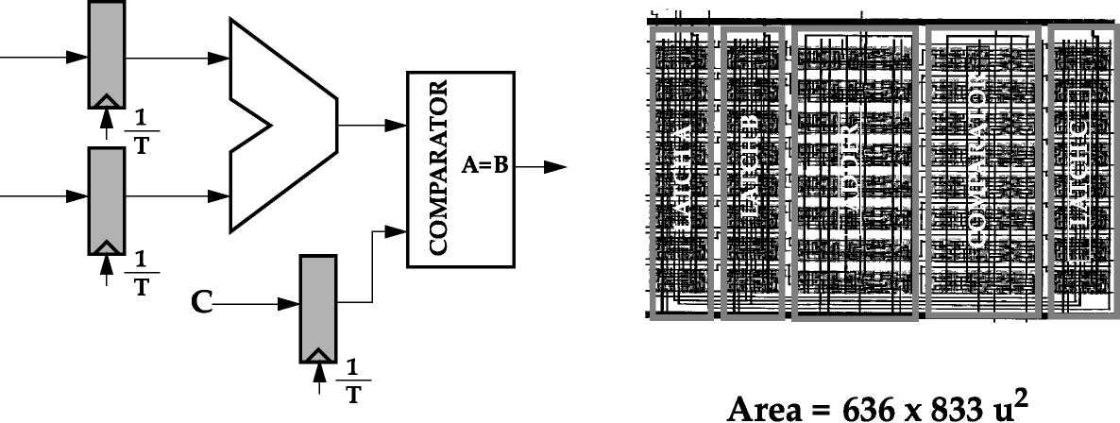
Parallel Architecture Example
Reference Data path
Critical path delay T_{adder} + T_{comparator} (= 25 ns)
➔ f_{ref} = 40 MHz
Total capacitance being switched = C_{ref}
V_{DD} = V_{ref} = 5V
Power for reference datapath = P_{ref} = C_{ref} V_{ref}² f_{ref}
A
B

Slide 34
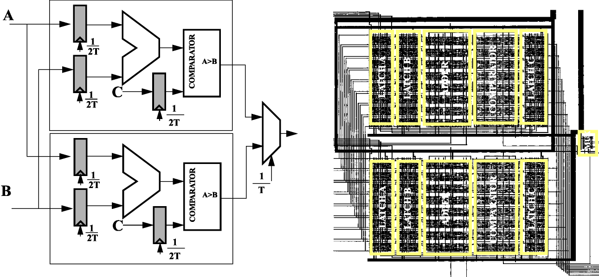
Parallel Architecture Example
Area = 1476 x 1219 µ²
The clock rate can be reduced by half with the same throughput f_{par} = f_{ref} / 2
V_{par} = V_{ref} / 1.7, C_{par} = 2.15 C_{ref}
P_{par} = (2.15 C_{ref}) (V_{ref} / 1.7)² (f_{ref} / 2) = 0.36 P_{ref}

Slide 35
Reducing Capacitance
Capacitance from switching is a result of wire lengths and transistors in a circuit.
Wire capacitance can be minimized through component floor planning and placement (locality of a structured design)
Units who exchange large amounts of data should be placed next to one another to reduce wire lengths
Device level switching is reduced by choosing fewer stages of logic and smaller transistors.

Slide 36
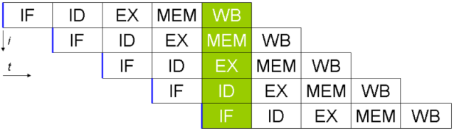
Pipeline Architecture
Reduces the propagation time of a block by factor N
➔ Voltage can be reduced at constant clock frequency
Constant throughput (after latency)
Area A
A/N
A/N
A/N
CLK
Data
Data
CLK

Slide 37
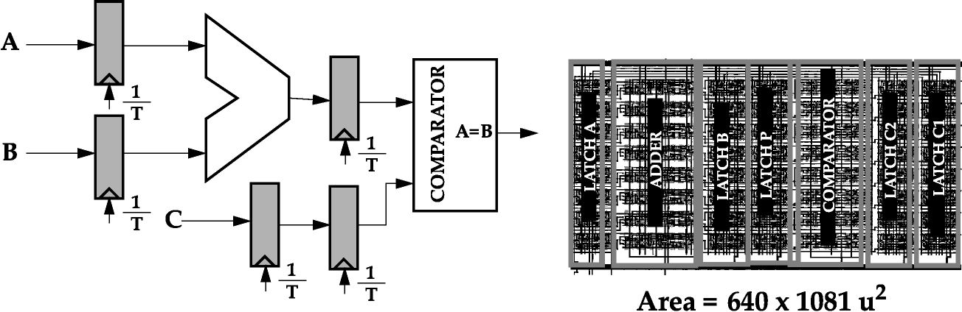
Pipelined Architecture Example
f_{pipe} = f_{ref,} , C_{pipe} = 1.1 C_{ref} , V_{pipe} = V_{ref} / 1.7
Voltage can be dropped while maintaining the original throughput
P_{pipe} = C_{pipe}V_{pipe}² f_{pipe} = (1.1 C_{ref}) (V_{ref}/1.7)² f_{ref} = 0.37 P_{ref}

Slide 38
Parallel vs. Pipeline Architecture
 | N-parallel proc. | N-stage pipeline proc.
Capacitance | N*C_{ref} | C_{ref}
Voltage | V_{ref}/N | V_{ref}/N
Frequency | f_{ref}/N | f_{ref}
Dynamic Power | C_{ref}V_{ref}²f_{ref}/N² | C_{ref}V_{ref}²f_{ref}/N²
Chip area | N times | 10-20% increase

Slide 39
Reducing Capacitance
Gates that are large and/or have a high activity factor have a large amount of power consumption, can be downsized with only a small performance impact .
Example: Buffers driving I/O or long wires may use 8-12 stages to reduce the buffer size.
Wire capacitance dominates many circuits
There are no closed form methods to determine gate sizes that minimize energy under a delay constraint.

Slide 40
Voltage
Voltage has a quadratic effect on dynamic power, therefore choosing a lower supply significantly reduce power consumption (lowering vdd by ½ can lead to a savings of ¼ dynamic power)
Chip can be partitioned into multiple voltage domains optimized for a specific needs. (memory cells can use high voltage for stability, medium voltage for processors, and low voltage for I/O peripherals)
Sleep mode turns off voltage domains entirely saving leakage power
Different operating modes can adjust voltage operation (laptop operating on AC adapter vs. battery)
If frequency and voltage scale down in proportion, a cubic power reduction can be achieved.

Slide 41
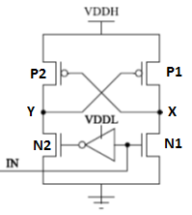
Level Converters
A standard method to handle voltage domain crossing is to use a level converter which behaves as a buffer and drives the output between 0 and VDDH without risk of transistors remaining partially on
When the input In =0
  N1→off N2→on
  N2 pulls Y to 0 → turns on P1
  P1 on →pulls X up to VDDH, and ensuring that P2 turns off
Level converter cost delay and power at each crossing which can be alleviated by building the converter into a register and only crossing voltage domains on clock cycle boundaries

Slide 42
Clustered Voltage Scaling
The simplest way to use voltage domains is to use different voltages with a large area of the floor plan, allowing each domain to receive its own power grid
Since the level converters require two different power supplies, they should be placed near the domain where necessary for crossing
An alternative approach is clustered voltage scaling, in which two supply voltages can be used in a single block.

Slide 43
Data Paths
Data propagate through different data paths between registers
Paths mostly differ in propagation delay times
Frequency of clock signal (CLK) depends on path with longest delay ➔ critical path
Paths
Path

Slide 44
Clustered Voltage Scaling
  Critical paths are assigned V_{DDH} (high performance needed)
  Non-Critical paths are assigned V_{DDL} (only low performance demands)
  Each path starts with V_{DDH} and switches to V_{DDL} (red gates) when slack is available
  V_{DDL} gates never crosses into V_{DDH} so level converters are only required at input of registers
Connected with V_{DDL}
Connected with V_{DDH}

Slide 45
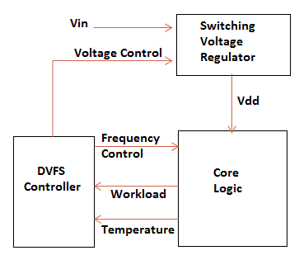
Dynamic Voltage Frequency Scaling
Many systems have time varying performance requirements (Solitaire vs. PSPICE). Systems can save energy by reducing the clock frequency to the minimum sufficient to complete the task on schedule, then reducing the voltage to the minimum necessary to operate at that frequency. This is called dynamic voltage/frequency scaling (DVFS).
A DVS controller takes in information about the system (temperature/workload) and determines the supply voltage and frequency sufficient to complete the workload on schedule or to maximize performance without over heating. A switching Vreg steps down Vin from a high value to the necessary Vdd. The core logic contains a PLL to generate the specified clock frequency which is determined by the DVS controller.

Slide 46
Frequency and Short-Circuit Current
Dynamic power is directly proportional to frequency, so a chip should not run faster than necessary
Reducing the frequency also allows downsizing transistors or using a lower supply voltage
Larger output load capacitance reduces short-circuit power dissipation because with a larger load, the output switches a small amount during the input transition (gate output transition should not be faster than the input transition). The larger capacitor takes most of the current.
Short circuit power is about 5-10% of dynamic power and can be ignored in hand calculations

Slide 47
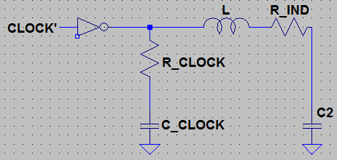
Resonant Circuits
Resonant Circuits seek to reduce dynamic power by letting the energy be store in storage elements rather than be dumped to ground.
Resonant Clock Network (shown above). C_CLOCK is the capacitance of the clock network, and in a ordinary clock circuit, it is driven between VDD and GND by a clock buffer. The clock network adds L1 and C2 which is approximately 10*C_CLOCK. The resistors represent losses in the clock wires and in the inductor that lower the quality of the resonator. In this circuit the energy moves back and forth between L1 and the C_CLOCK, which causes a sinusoid oscillation with a resonant frequency f. C2 must be large enough to store excess energy and not interfere with resonance of the clock capacitance.
IBM used a resonant global clock structure to reduce chip power by 10% at 4-5 GHz for the cell processor [Chan 09]

Slide 48
Reducing Static Power-
Dual Threshold Gates
Scaled device
I_{c}
Short-Channel Devices
(channel length comparable to depth of drain and source junctions and depletion width
I_{DS}= μ₀ C_{ox}(W/L)V_{t}² exp{(V_{GS} –V_{TH} + ηV_{DS})/nV_{t}}
Log (Drain current)
V_{DS} = drain to source voltage
η: a proportionality factor
I_{sub}
Decreasing the threshold voltage
Increases the sub-threshold current; solution- Dual threshold gates
0
V_{TH}’
V_{TH}
Gate voltage

Slide 49
Dual Threshold Voltage
Two different gate types:
Gates consist of low-V_{th} transistors
Low threshold voltage or thin gate oxide layer
For critical paths
High leakage
“LVT / LTO”-Gates
Gate consist of high-V_{th} transistors
High threshold voltage or thick gate oxide layer
For uncritical paths
Low leakage
“HVT / HTO”-Gate

Slide 50
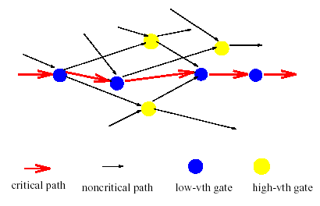
Dual Threshold Voltages
Some gates on non-critical paths may also be assigned low V_{th} to prevent those paths from becoming critical.

Slide 51
Dual Threshold Voltage Example
A circuit is designed in 65 nm technology using low threshold transistors. Each gate has a delay of 5ps and a leakage current of 10nA. Given that a gate with high threshold transistors has a delay of 12ps and leakage of 1nA, optimally design the circuit with dual-threshold gates to minimize the leakage current without increasing the critical path delay. What is the percentage reduction in leakage power?

Slide 52
Dual Threshold Voltage Example
The critical path is indicated with the dashed line, and each gat is assigned low threshold. The critical path delay is then 5ps *5 = 25 ps. We then assign high threshold (light grey gates) to all gates not on the critical path, except the two inverters which are assigned low threshold. If we were to assign them as high threshold, the critical path would be (12+5+12) = 29ps (Inverter →OR → Inverter). By making the inverter in the four-gate long path low threshold we also avoid making a non critical path critical (AND → NAND → OR → Inverter)
5ps
12ps
Reduction in Leakage Power
= 1 – [(4 * 1 nA) + (7*10 nA)]/(11*10 nA)
= 32.7%
Critical Path Delay
= 25 ps
5ps
12ps
5ps
5ps
5ps
5ps
12ps
5ps
12ps

Slide 53
Power Supply Gating
“The basic strategy of power gating is to provide two power modes: a low power mode
and an active mode. The goal is to switch
between these modes at the appropriate
time and in the appropriate manner to maximize power savings while minimizing the impact to performance.”

Slide 54
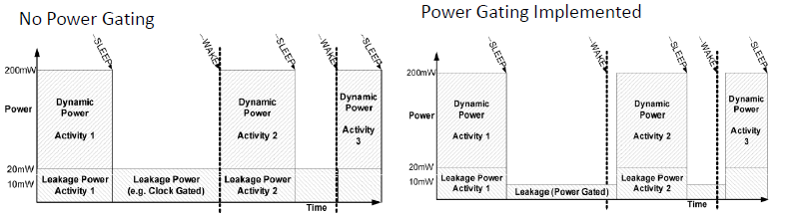
Power Supply Gating
Leakage power is now more than switching power
  Limits the performance of microprocessors
Power gating is one of the most effective ways of minimizing leakage power
  Cut-off power to inactive units/components
    Dynamic/workload based power gating
  Reduces both gate and sub-threshold leakage
  Over 20-2000x reduction in leakage with little or no cycle time penalty.

Slide 55
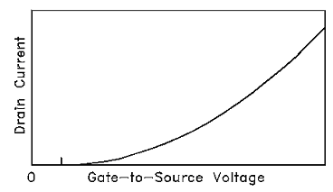
Recall
Leakage arises when there is a leakage current flow during standby mode. One of the biggest components of leakage in CMOS is the sub-threshold leakage current (current passing through drain to the source in the channel of a MOS device in the weak inversion region in which the diffusion current in caused by minority carriers. Example: low Vin to an inverter, in which a high potential voltage at output. In theory PMOS = on and NMOS = off, but NMOS is not completely off, since there is leakage current in the channel due to the Vdd potential of Vds.
Reduced in power gating
I_{DS}= μ₀ C_{ox}(W/L)V_{t}² exp{(V_{GS} –V_{TH} + ηV_{DS})/nV_{t}}
This graph shows that gate to source voltage increases exponentially with drain current. As a result, decreasing the transistor gate to source voltage will greatly reduce the leakage current and hence leakage power.

Slide 56
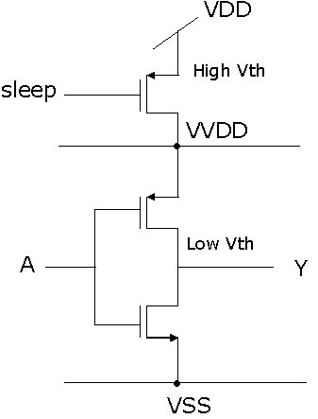
Power Gating Concept
A header switch (PMOS) is placed between a block and power to control supply power from this block with a sleep signal. When in active mode, the virtual voltage (WDD) is acting as a power supply (equal to VDD) to the block. In standby mode, the header is switched off meaning the virtual voltage begins to drop.
WDD is no longer VDD, but a voltage above VSS at saturation point (hence Vgs is reduced). When WDD starts to fall, leakage power savings in the block begins. There still exists leakage in the header, but the sleep transistors are usually made of high threshold devices preventing cell leakage while maintaining a high potential at virtual rail. This approach can be applied to footers (NMOS) which is placed between the logic block and ground. (Fine Grain)

Slide 57
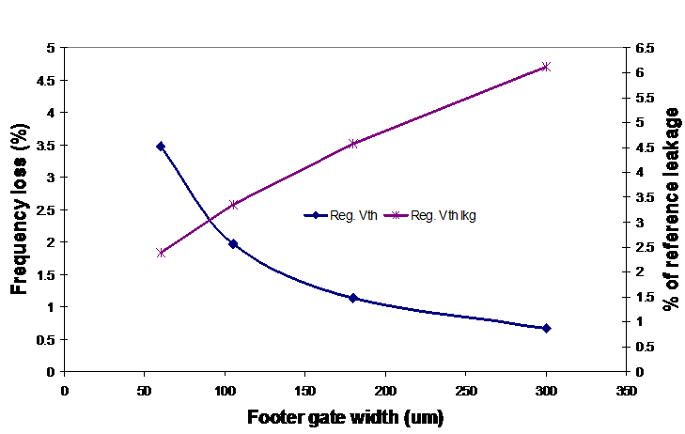
Power Gate Area vs. Frequency and Leakage Reduction

Slide 58
Power Gated ALU Network Savings
VDD
 | Normal X 10 ⁻⁶ (W) | Sleep X 10 ⁻⁶ (W) | Power Saving (%)
Avg. Dynamic Power | 660.0 | 0.322 | 99.95 %
Avg. Leakage Power | 34.01 | 0.241 | 99.29 %
Peak Power | 5040.5 | 1.361 | 99.79 %
Minimum Power | 29.254 | 127.4 | 99.56 %
Data 1
32 - bit
ALU
(Low V_{t})
32
Data 2
Data Out
32
32
Add / Sub
GND_V
Sleep Transistor Network
(High V_{t})
Sleep

Slide 59
Current Research in Low Power Design
Low Power VLSI Testing
  Input vector ordering, gated FFs for scan chains, power aware test schemes
  Low Power Test Pattern Design for VLSI Circuits Using Incorporate Pseudorandom and Deterministic Approach (2012
Low Power FPGAs
  Dynamic-controlled power gated FPGAs (2012)– reduces static energy dissipation during idle periods of operation
Ultra Low Power (ULP) Devices
  Pacemakers, hearing aids, etc.

Slide 60
Questions?

